Slide 1

An NSS Audio-Visual
Library Presentation
The Best of the
1992 NSS Photo Salon
National Speleological Society
S915 81 Slides 2/24/2021

Slide 2
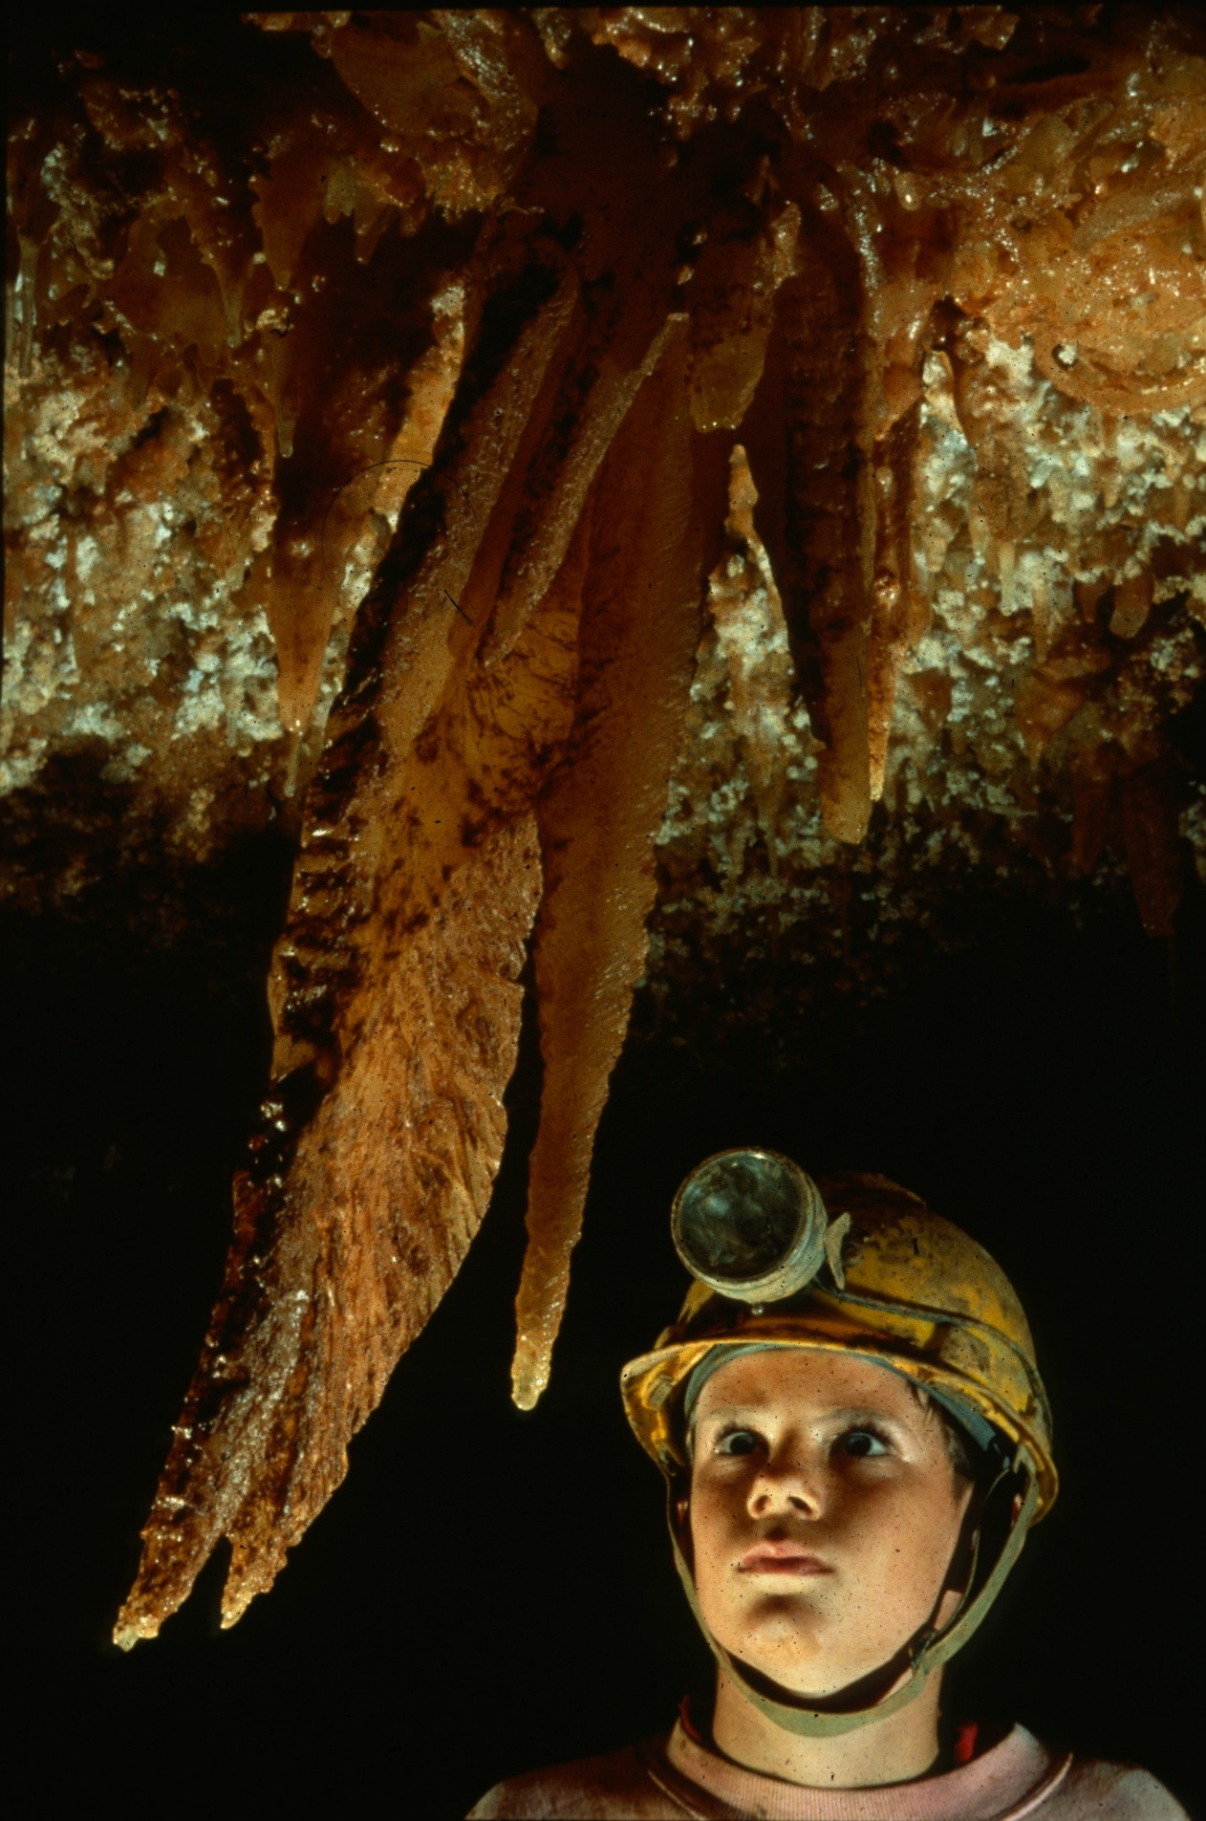
Notes:
The Blade – Rick Day

Slide 3
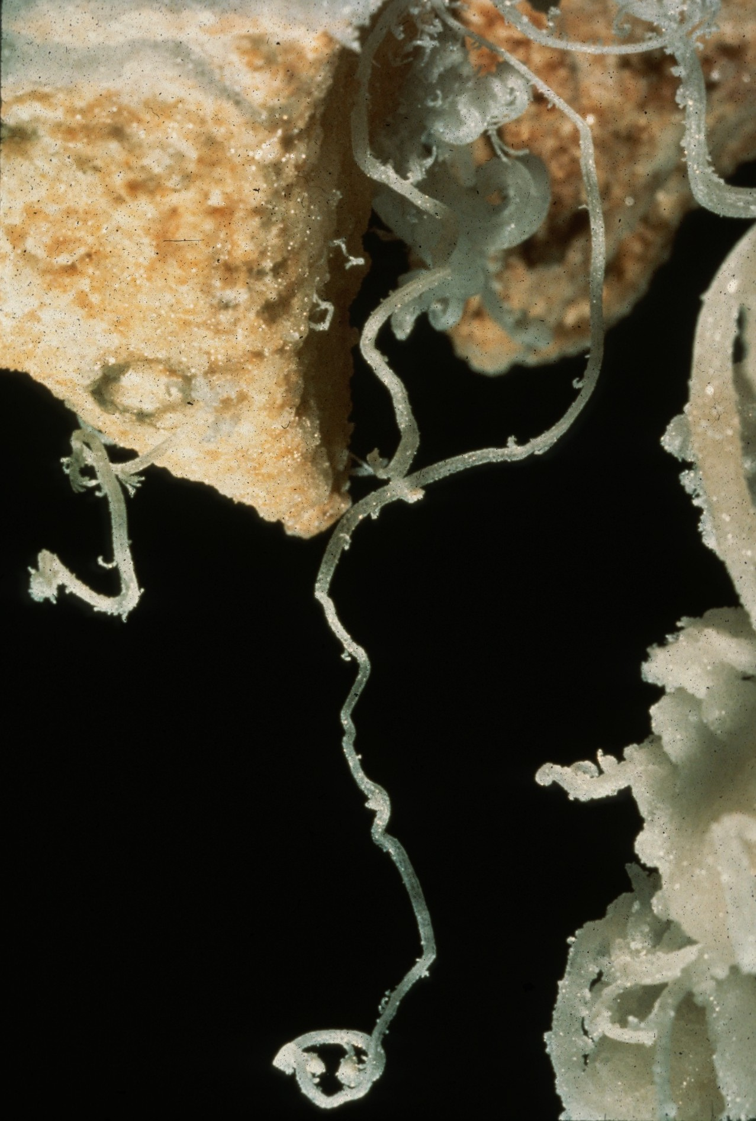
Notes:
Beneath the Yellow Brick Road – Peter Jones

Slide 4
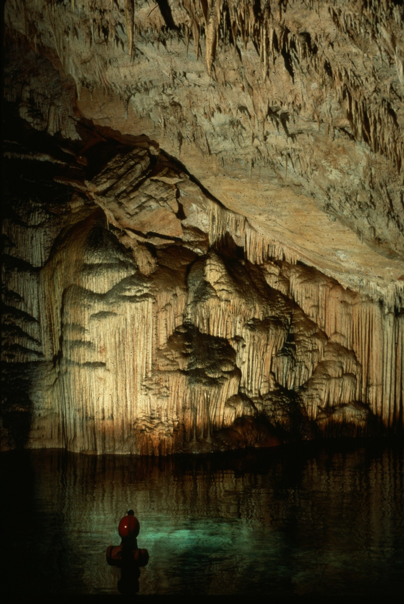
Notes:
Cathedral Cave Trapestry – Carolyn Cronk

Slide 5
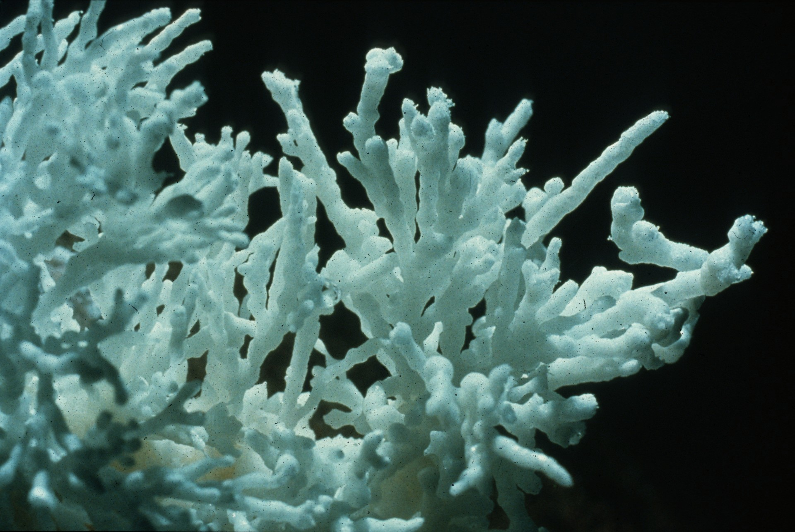
Notes:
Beaded Helictites, Silent Splendor – Chris Howes

Slide 6
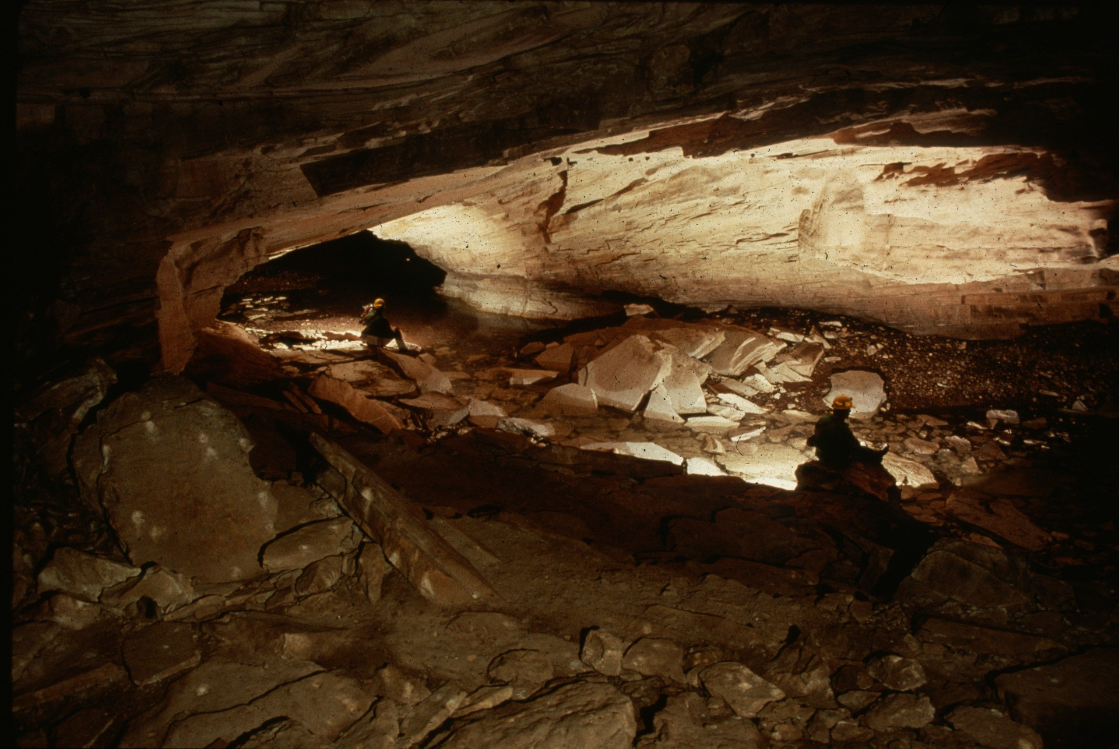
Notes:
Floored Ceiling – Horton Hobbs, III

Slide 7
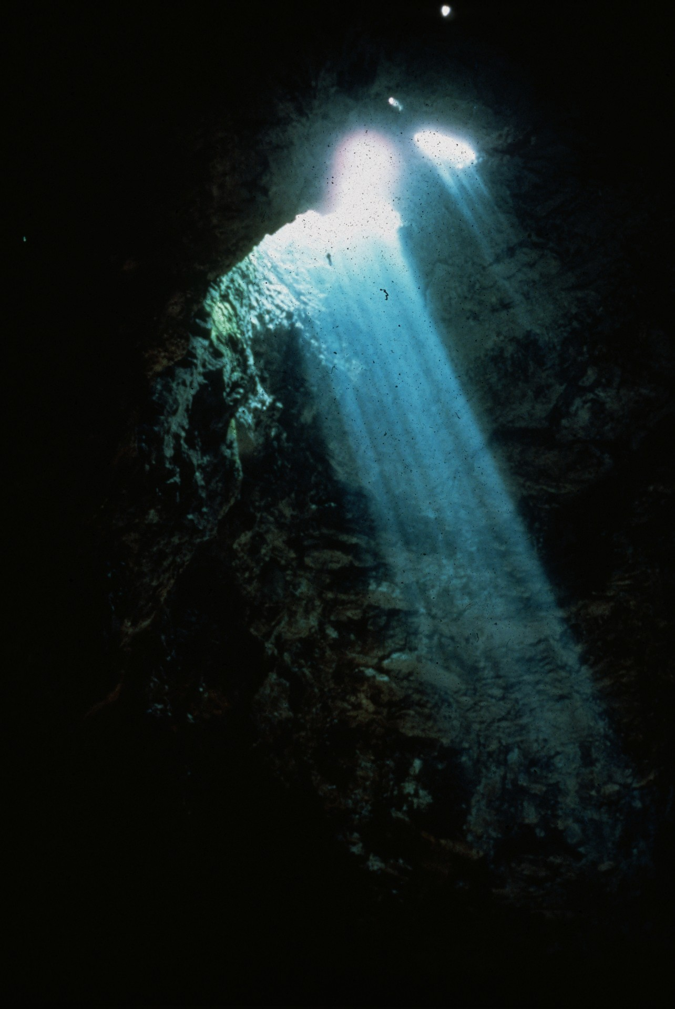
Notes:
Vance Nelson Descends into Sotano de la Cuesta – Louise Hose

Slide 8
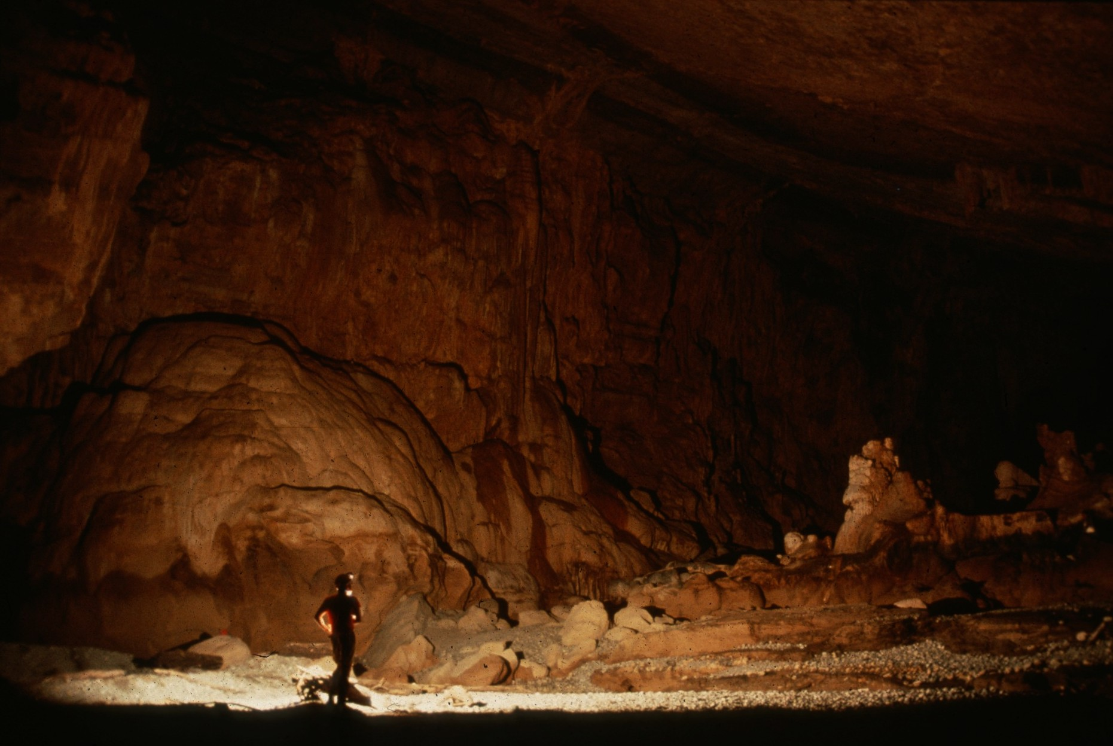
Notes:
Flowstone Ballroom – Maureen Handler

Slide 9
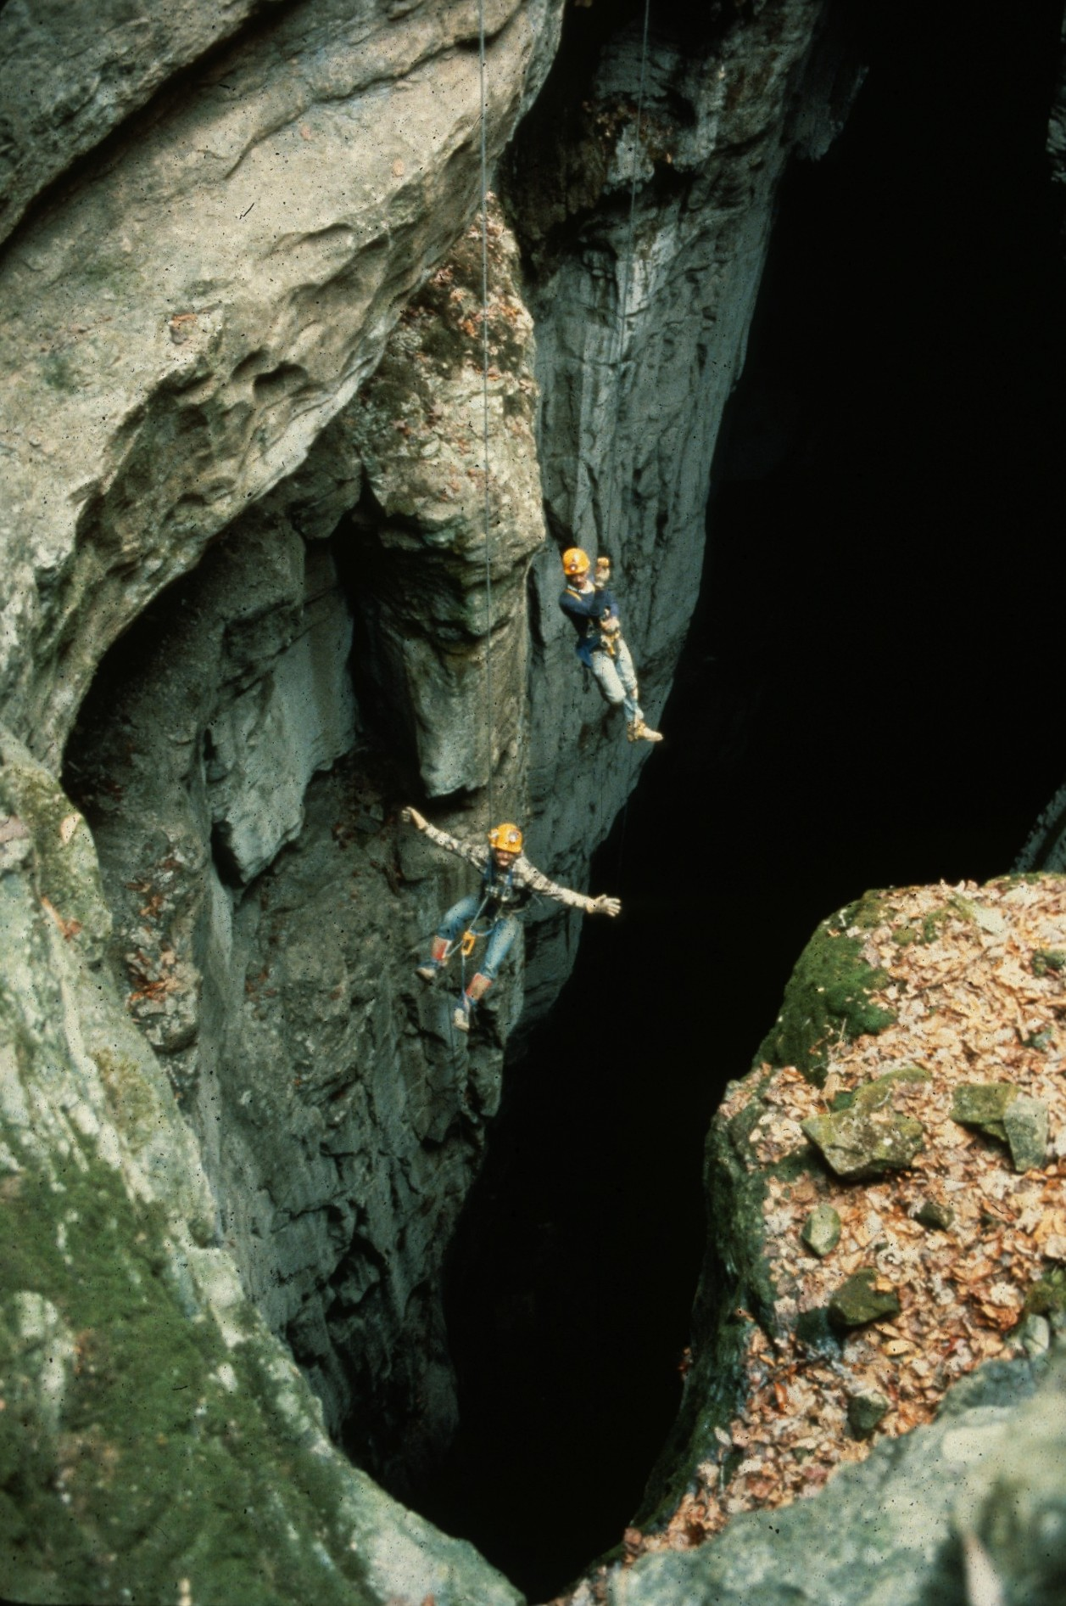
Notes:
Wheee… - Horton Hobbs, III

Slide 10
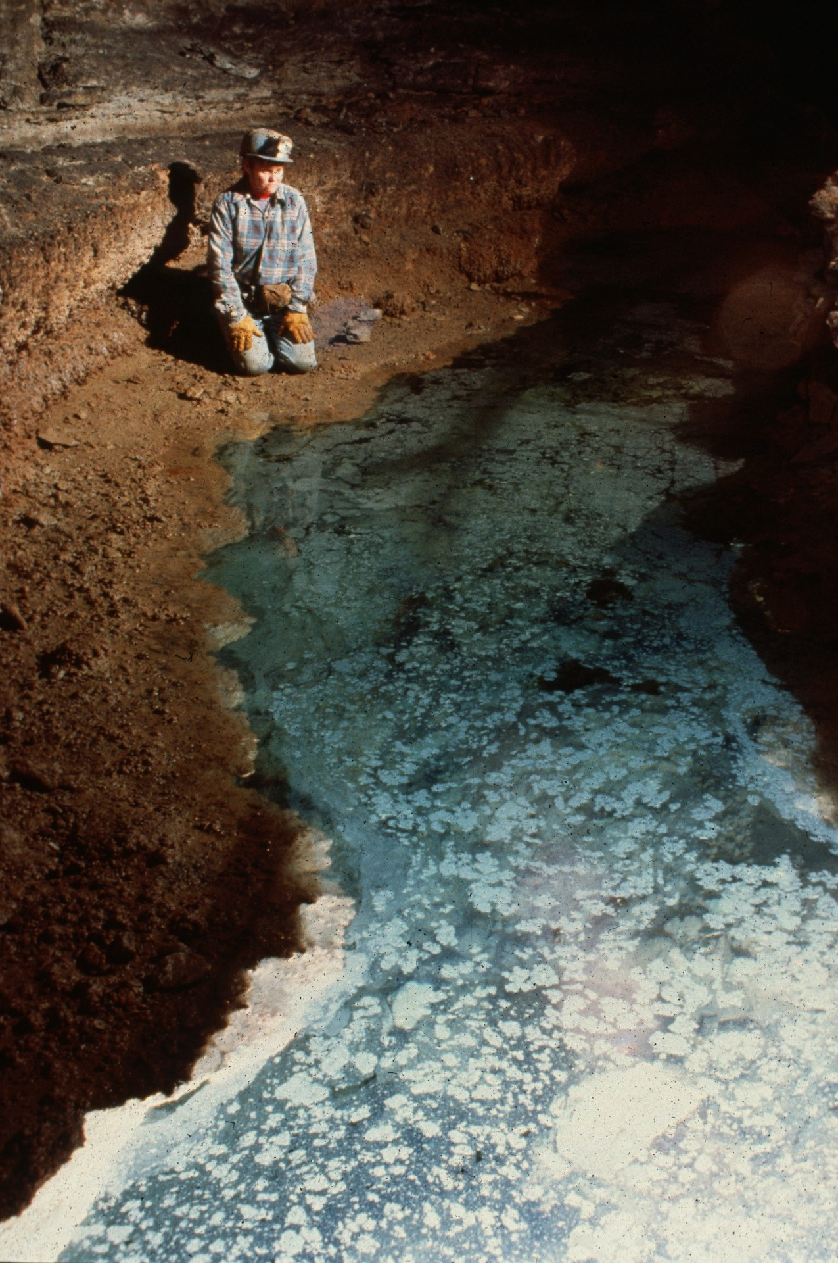
Notes:
Calcite Raft Boardwalk – Rick Day

Slide 11
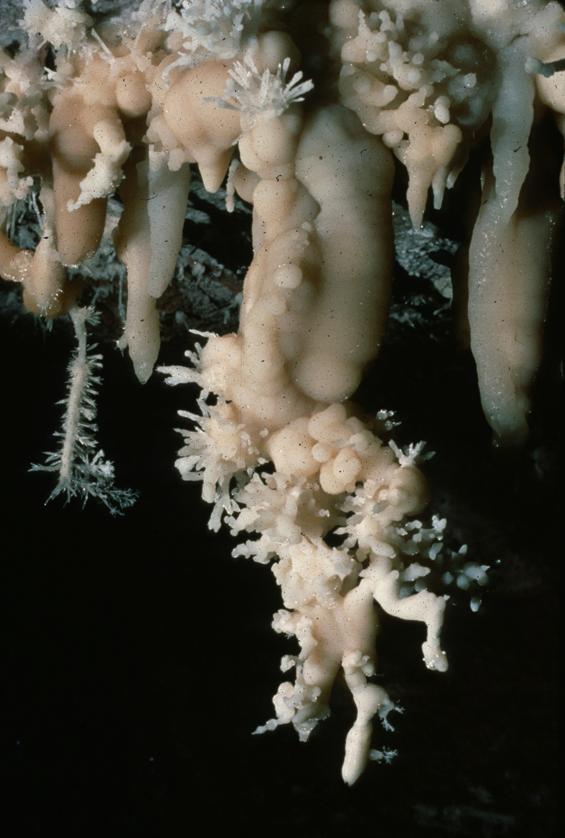
Notes:
The Long and Skinny of it – Scott Fee

Slide 12
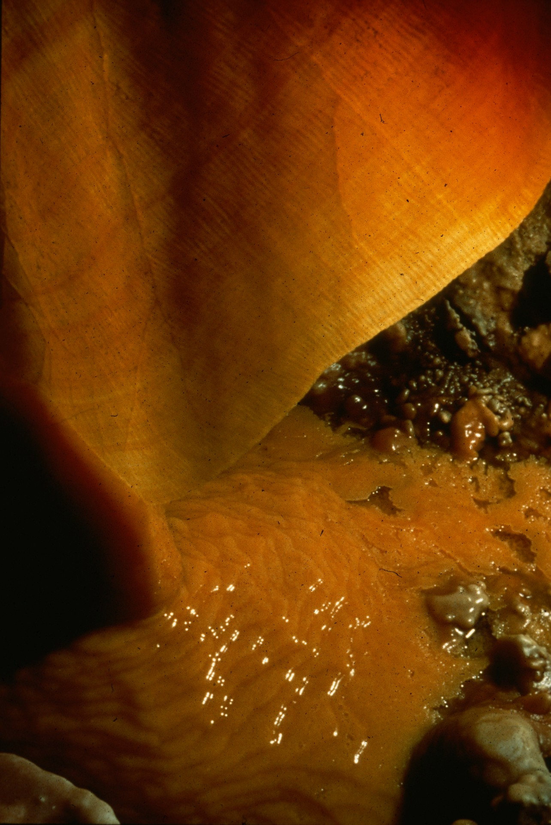
Notes:
The Curtain Dissolves – Rick Day

Slide 13
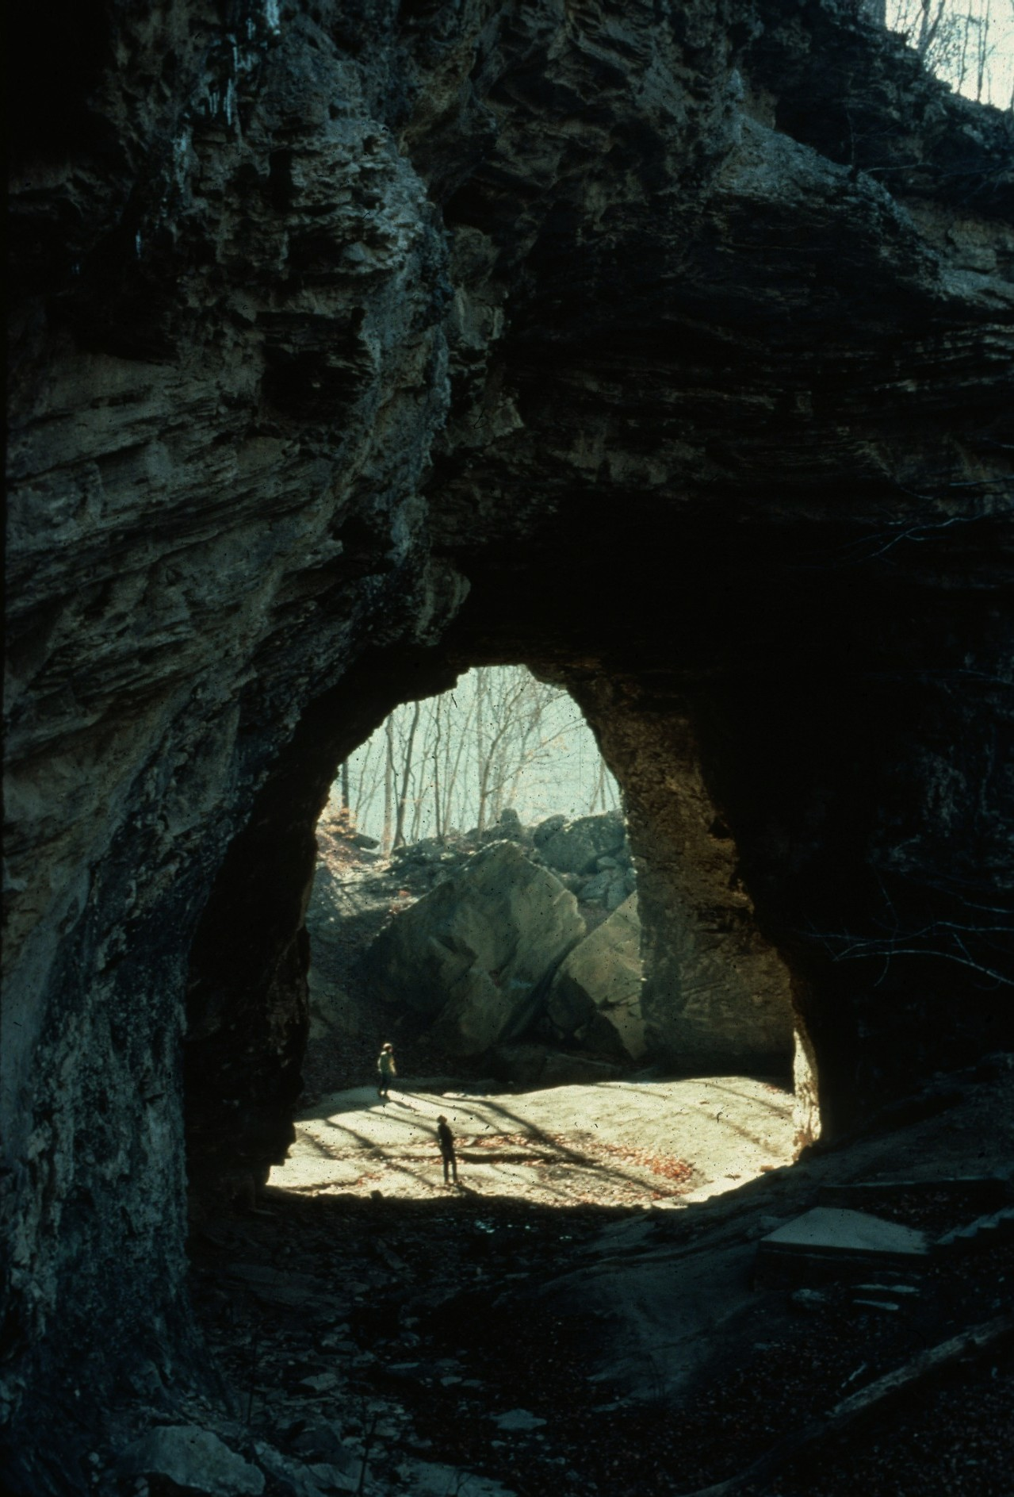
Notes:
Caves Aren’t Permanent – Horton Hobbs, III

Slide 14
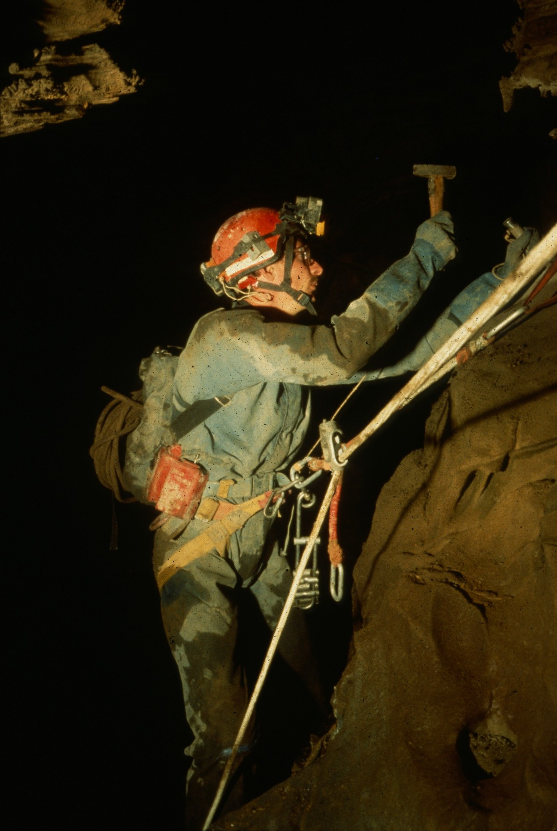
Notes:
Nita Xque Rebelay – William Storage

Slide 15
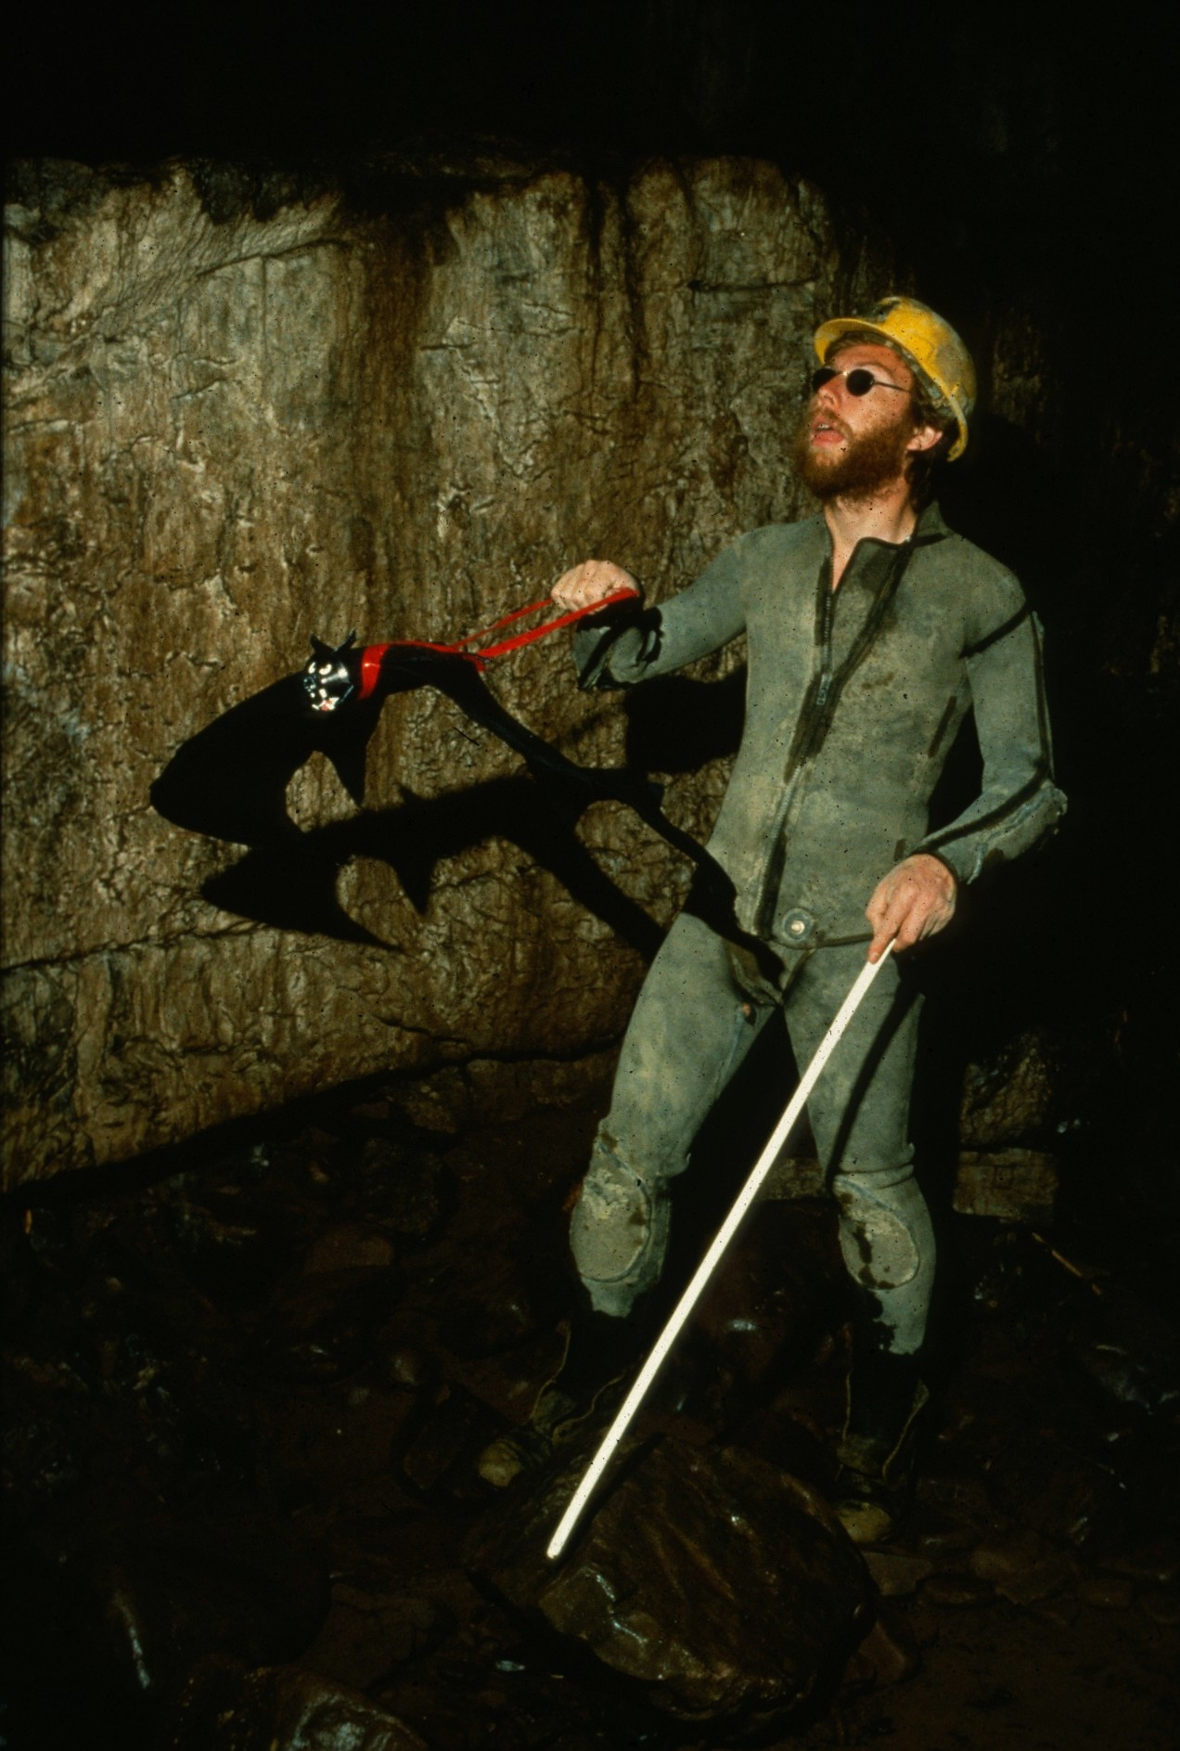
Notes:
Guide Bats for the Blind – Chris Howes

Slide 16
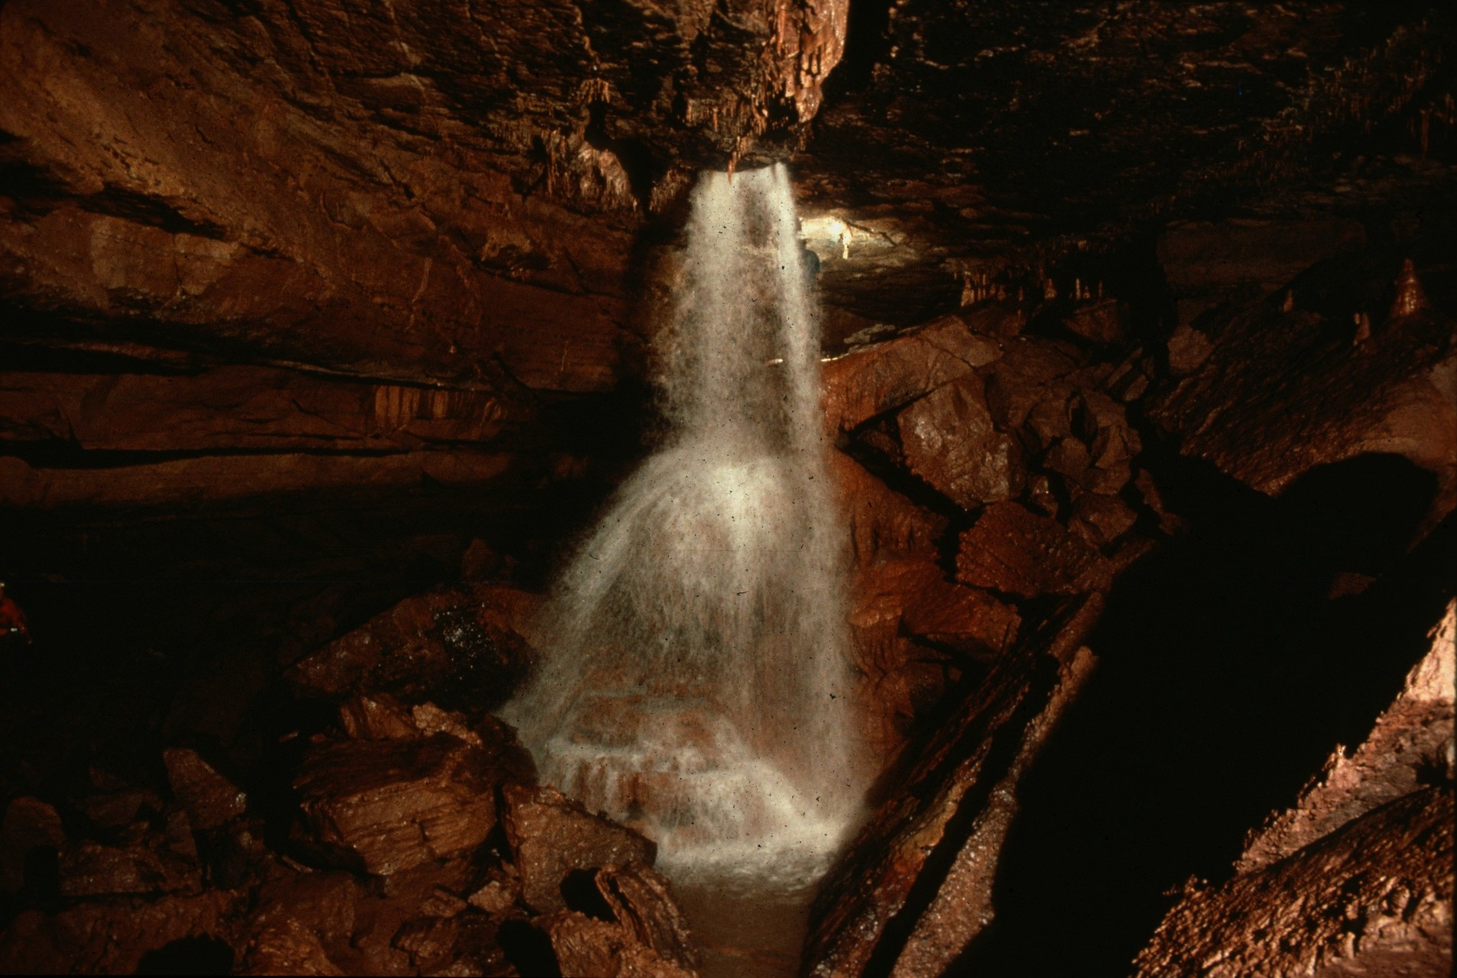
Notes:
Thunderbolt Falls – Ed McCarthy and Carl Samples

Slide 17
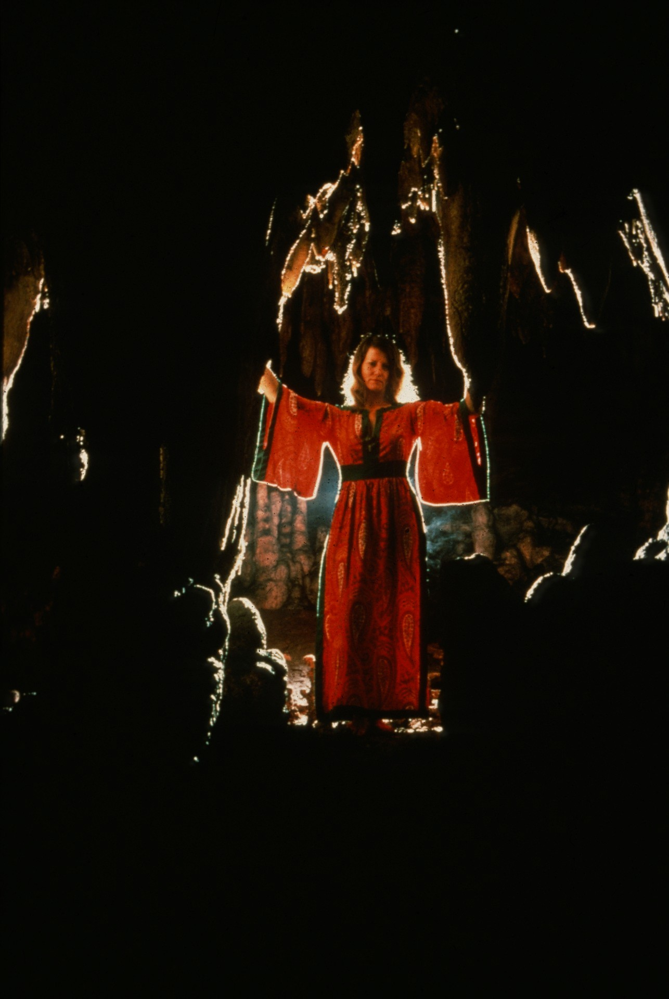
Notes:
The Spell Is Cast – John Van Swearingen

Slide 18
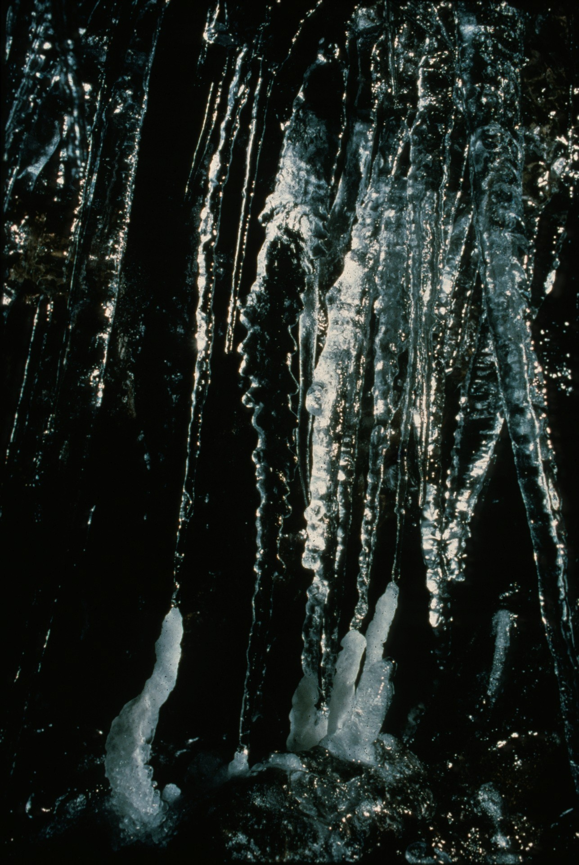
Notes:
Spele-Ice – Dave Bunnell

Slide 19
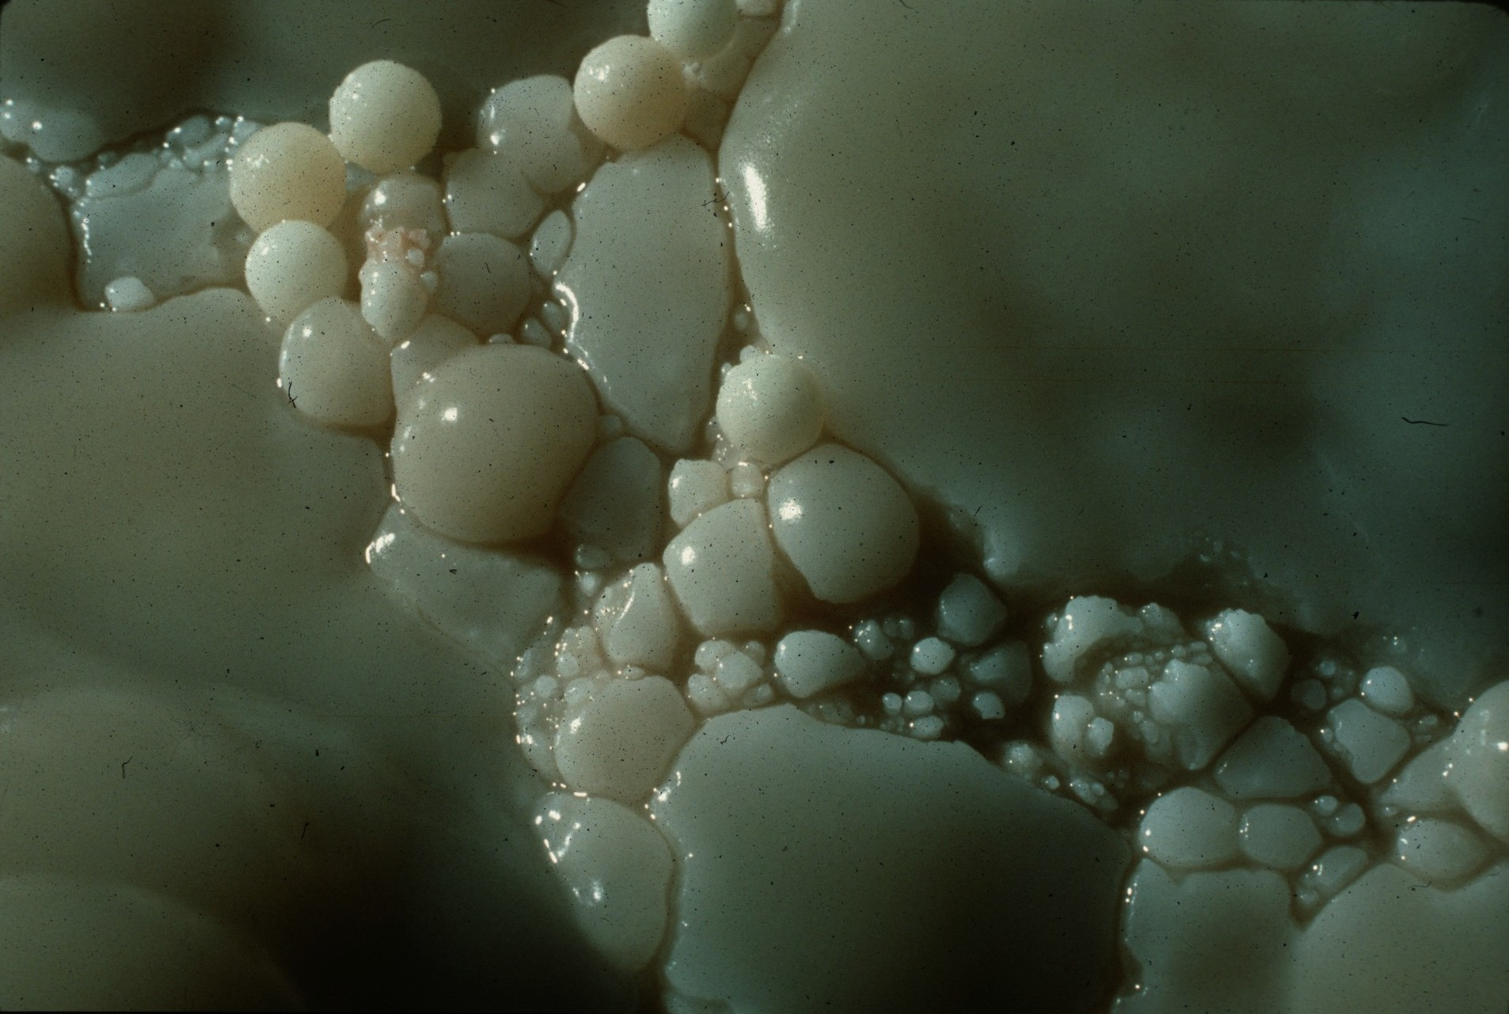
Notes:
Pearls of the Lost Marbles – Peter Jones

Slide 20
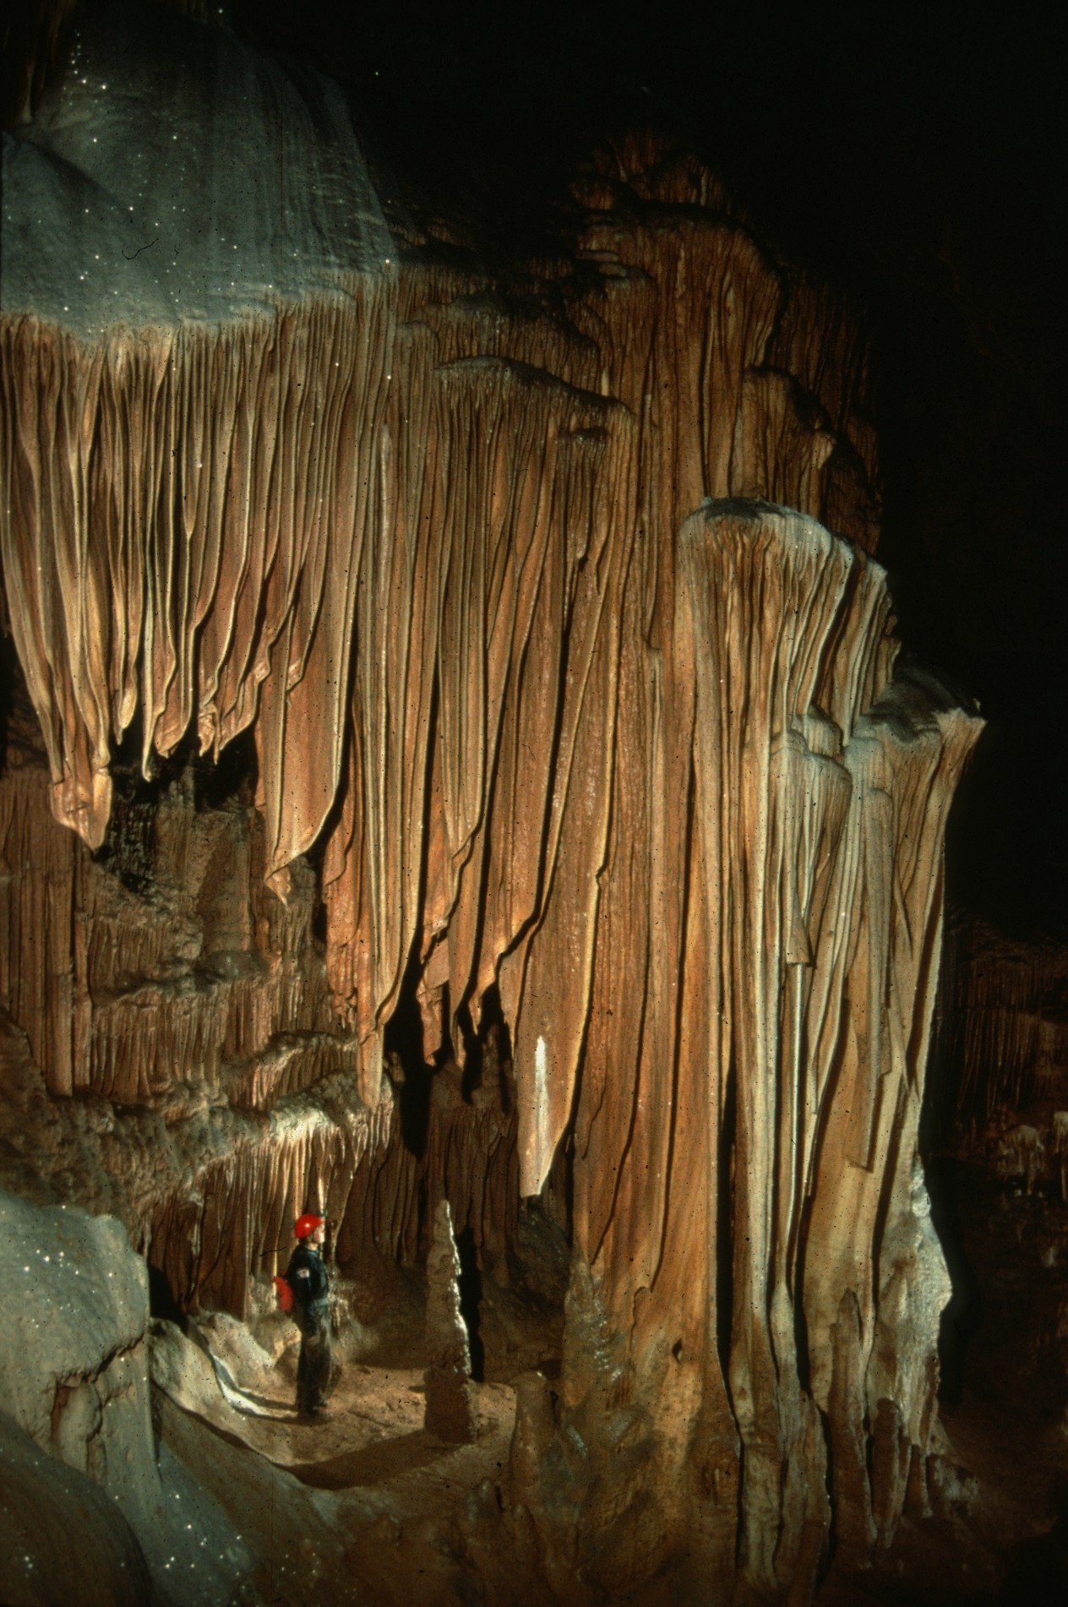
Notes:
The Mountain King’s Temple – Ralph Earlandson

Slide 21
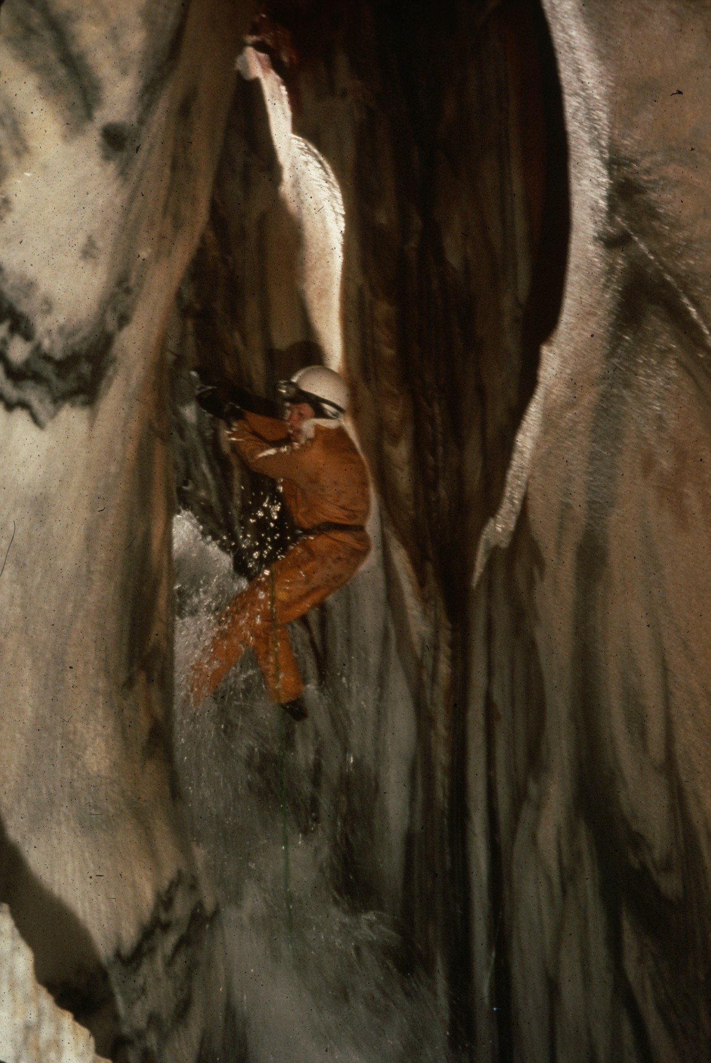
Notes:
Let’s Hear It For Handlines! – Peter and Ann Bosted

Slide 22
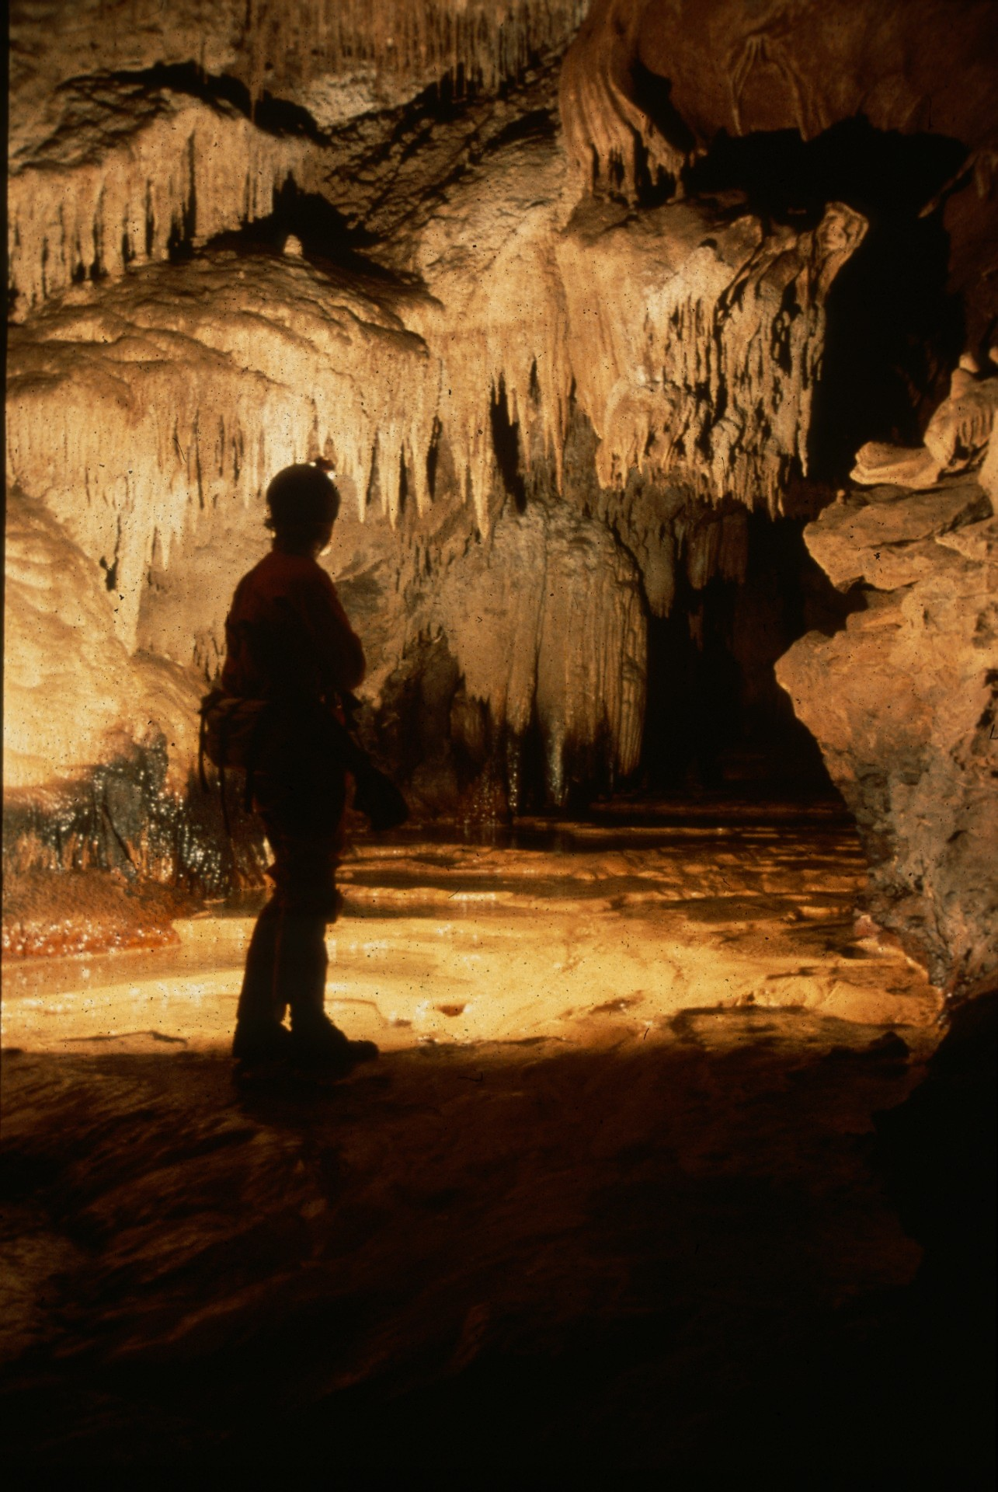
Notes:
Dragon Slayer – Maureen Handler

Slide 23
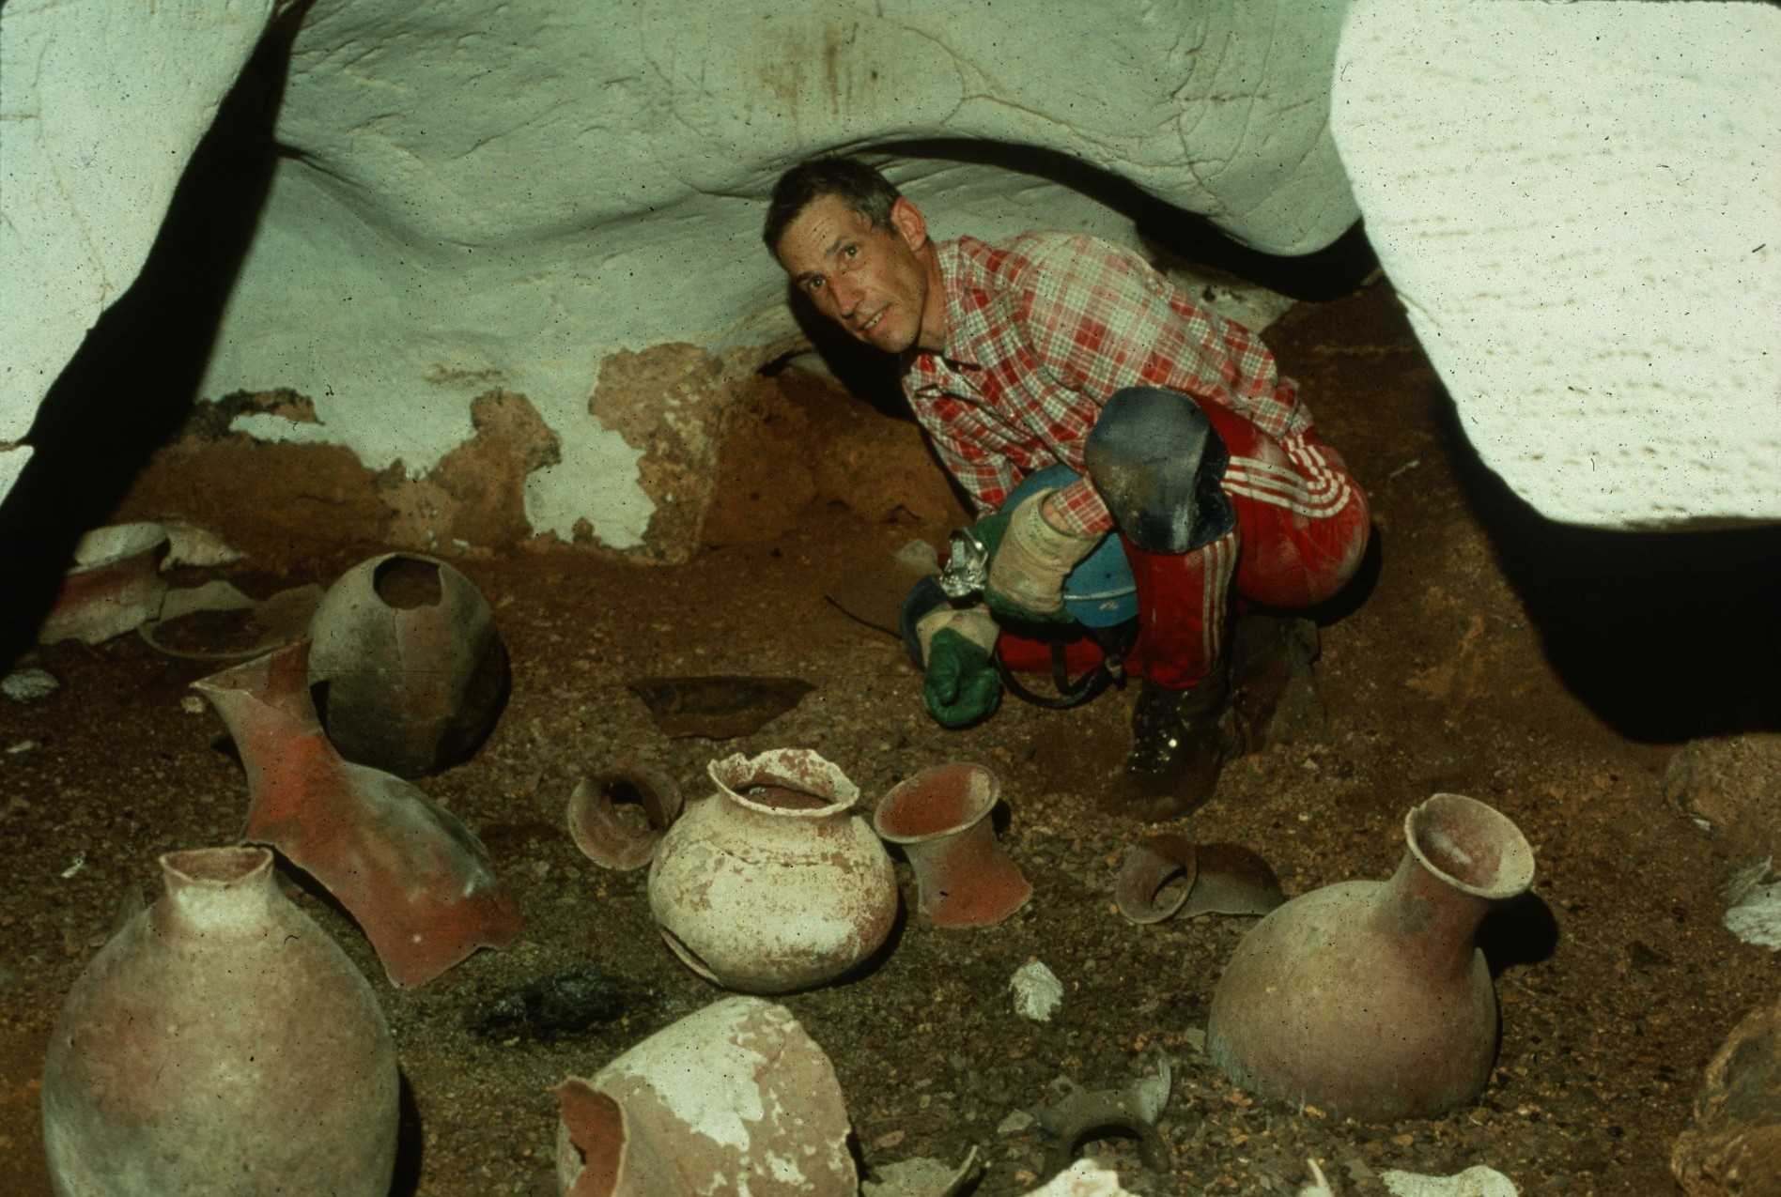
Notes:
Herb With Long Neck Vases – William Storage

Slide 24
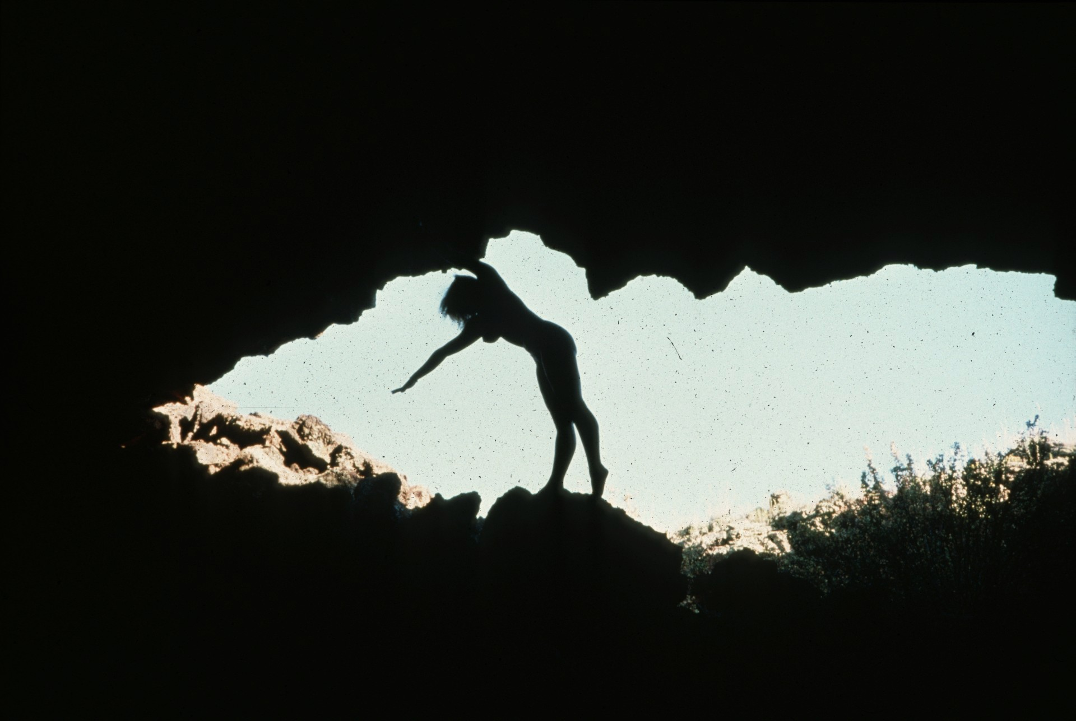
Notes:
Junction Cave, El Malpais – Pat Jablonsky

Slide 25
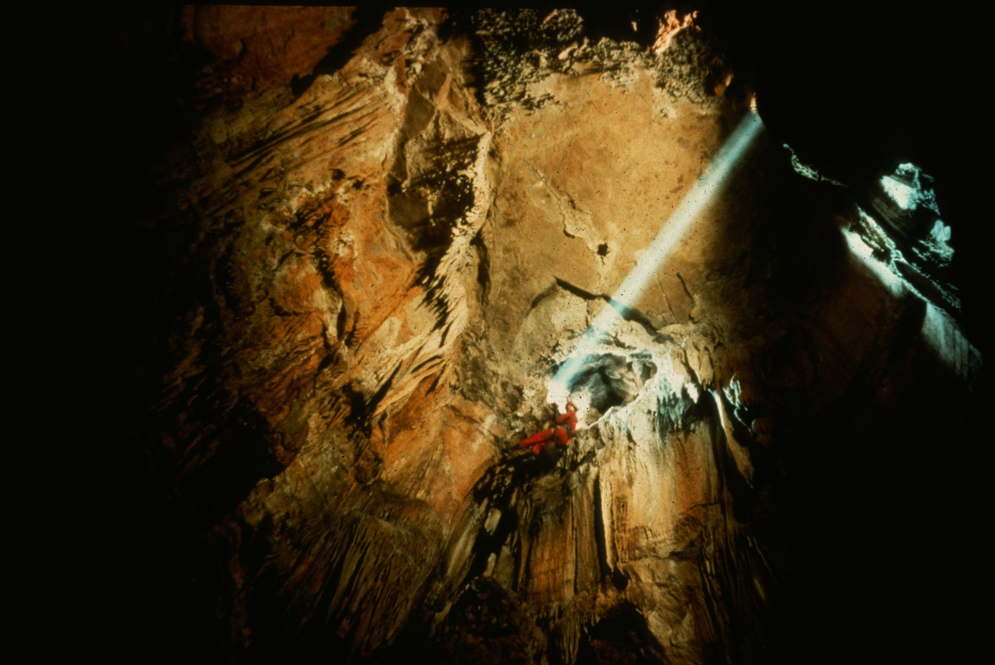
Notes:
A Ray of Hope – John Van Swearingen

Slide 26
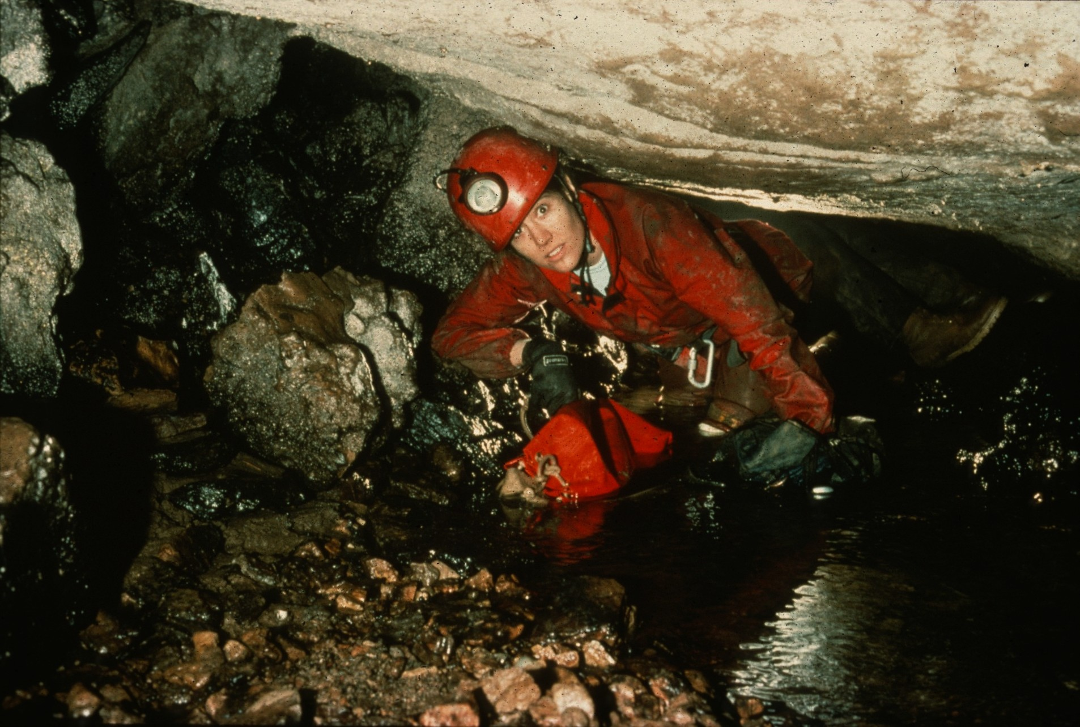
Notes:
Yes! IT Really Does Go – John Van Swearingen

Slide 27
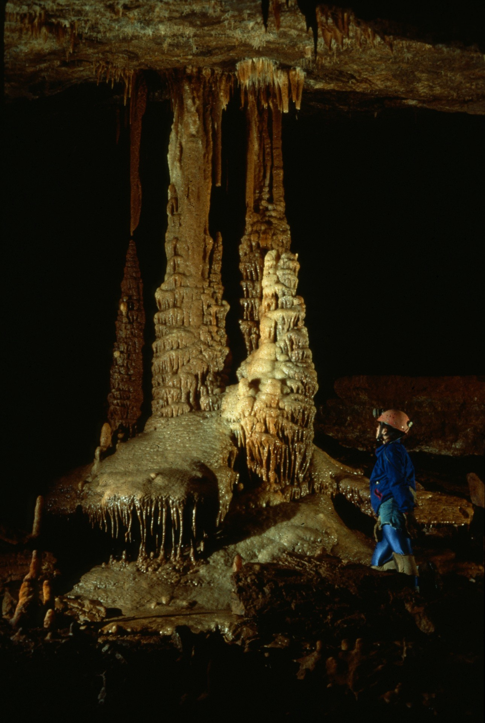
Notes:
At Trail’s End – Rick Day

Slide 28
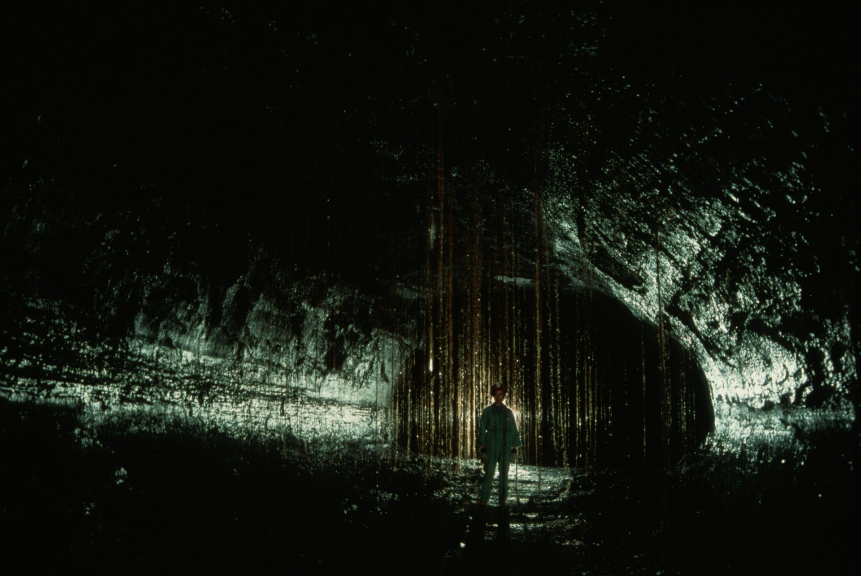
Notes:
Root Jungle – Dave Bunnell

Slide 29
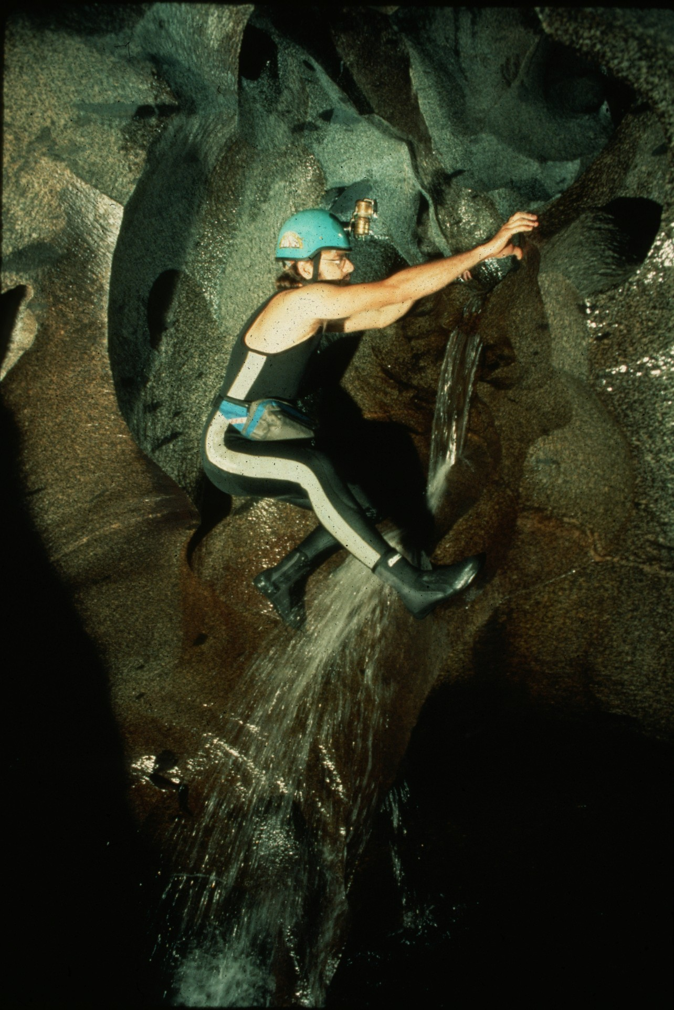
Notes:
Climbing Granite – Dave Bunnell

Slide 30
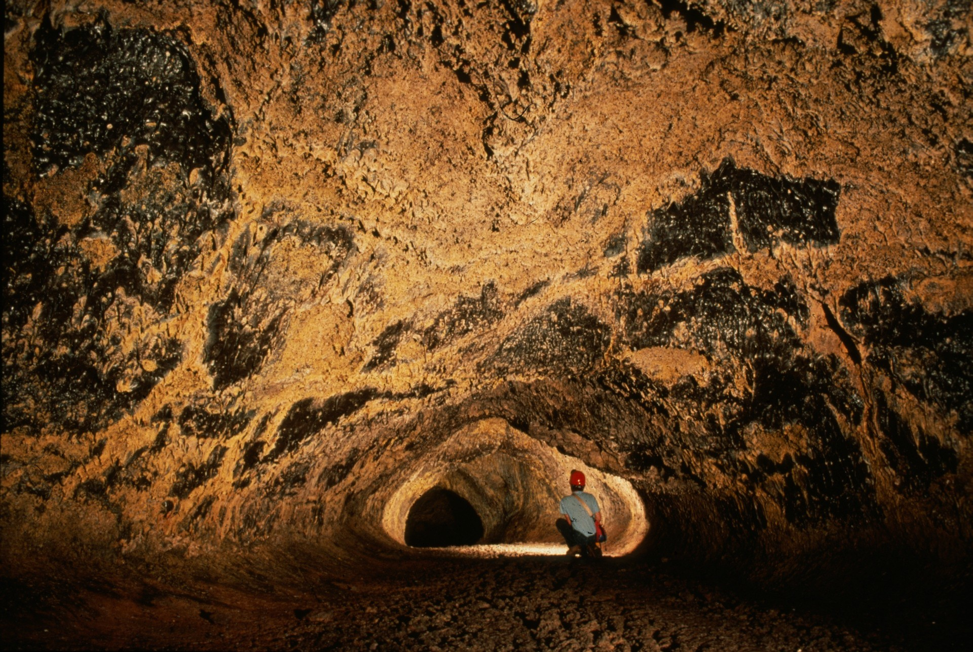
Notes:
Golden Gallery – Dave Bunnell

Slide 31
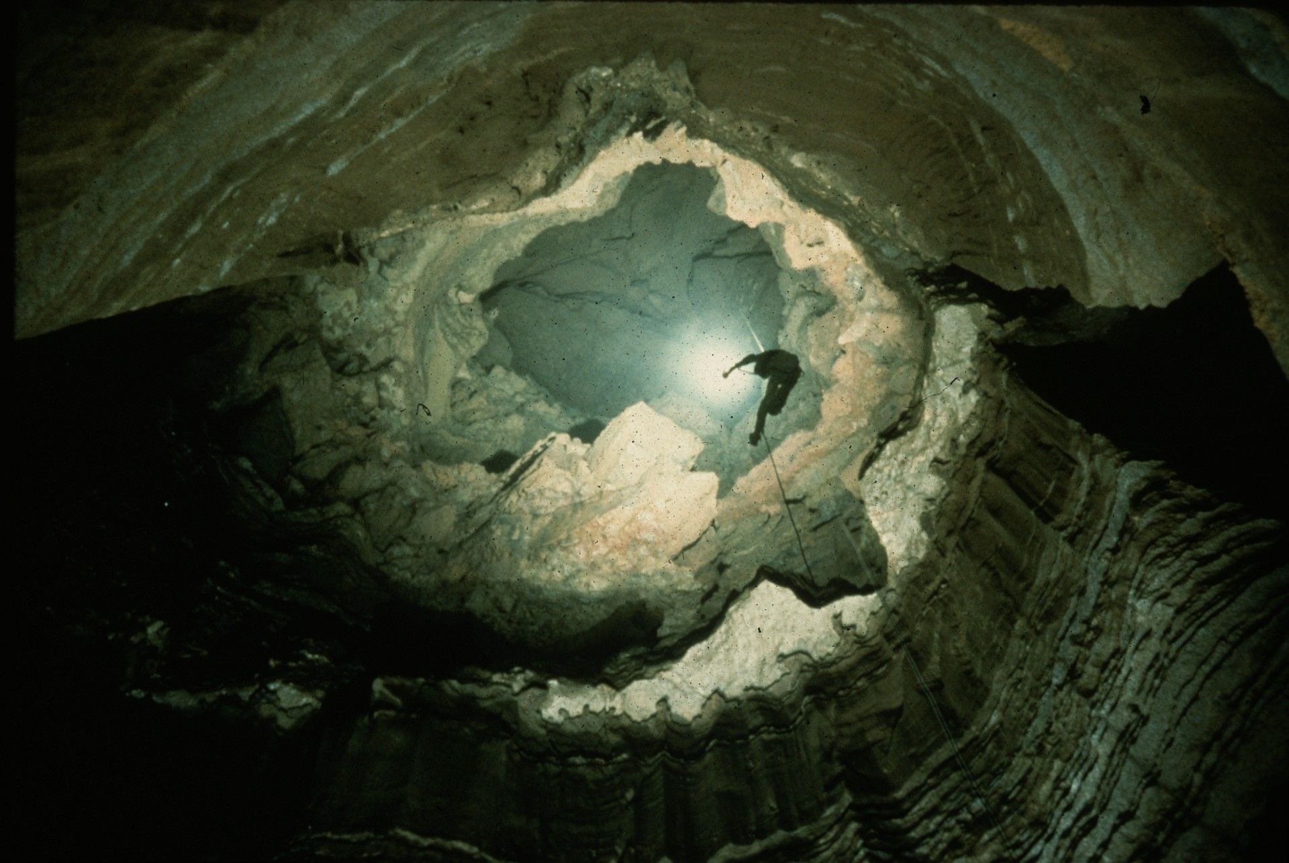
Notes:
Paint Rock River Pit – John Van Swearingen

Slide 32
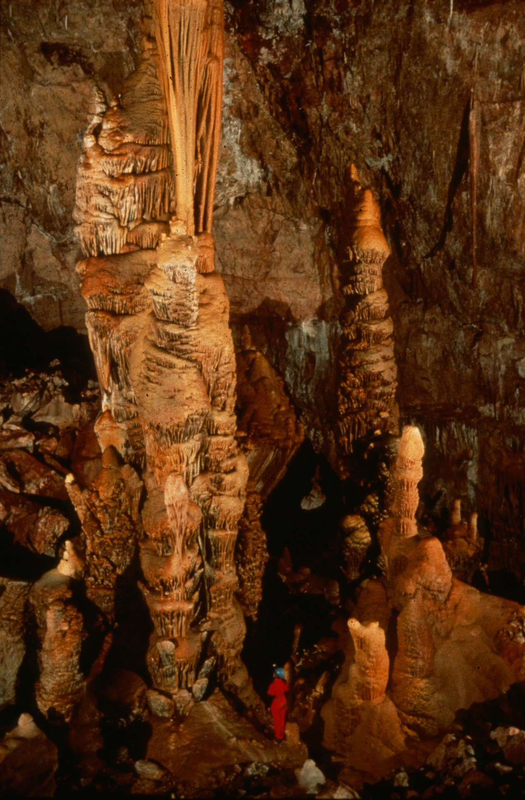
Notes:
Throne Room II – Rick Day

Slide 33
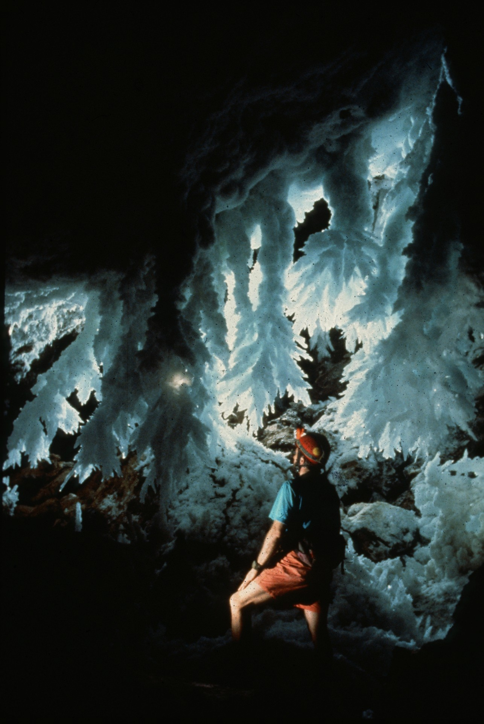
Notes:
(untitled) – Peter Jones

Slide 34
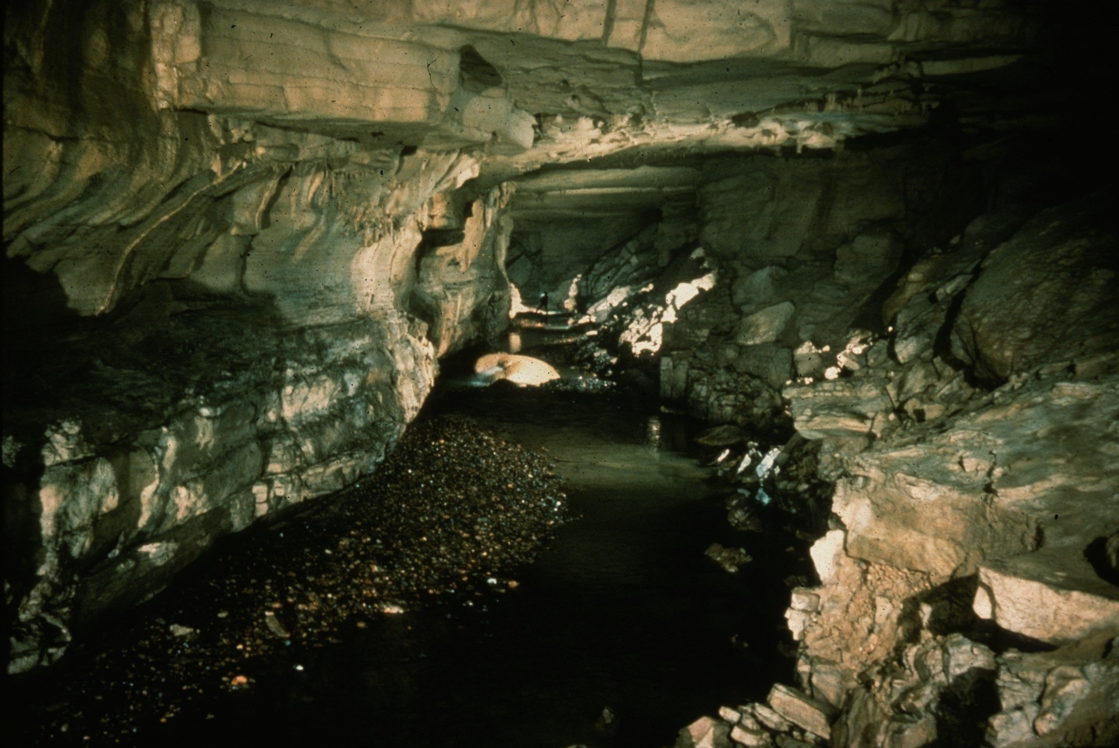
Notes:
King Cove Borehole – John Van Swearingen

Slide 35
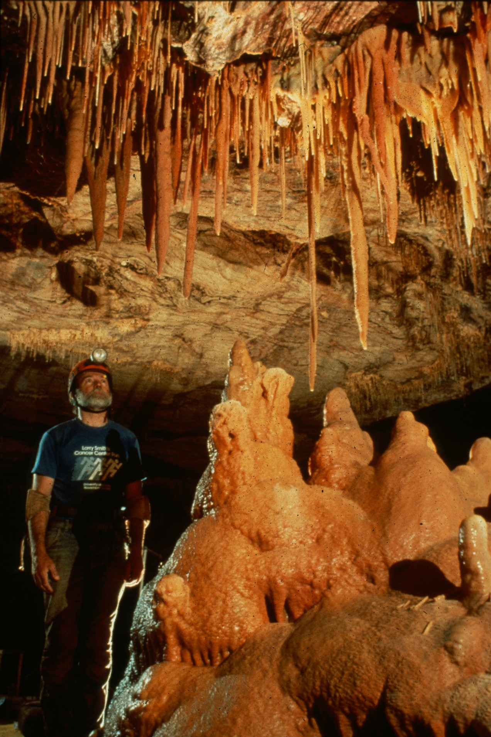
Notes:
Ben ‘N’ Beauty – Rick Day

Slide 36
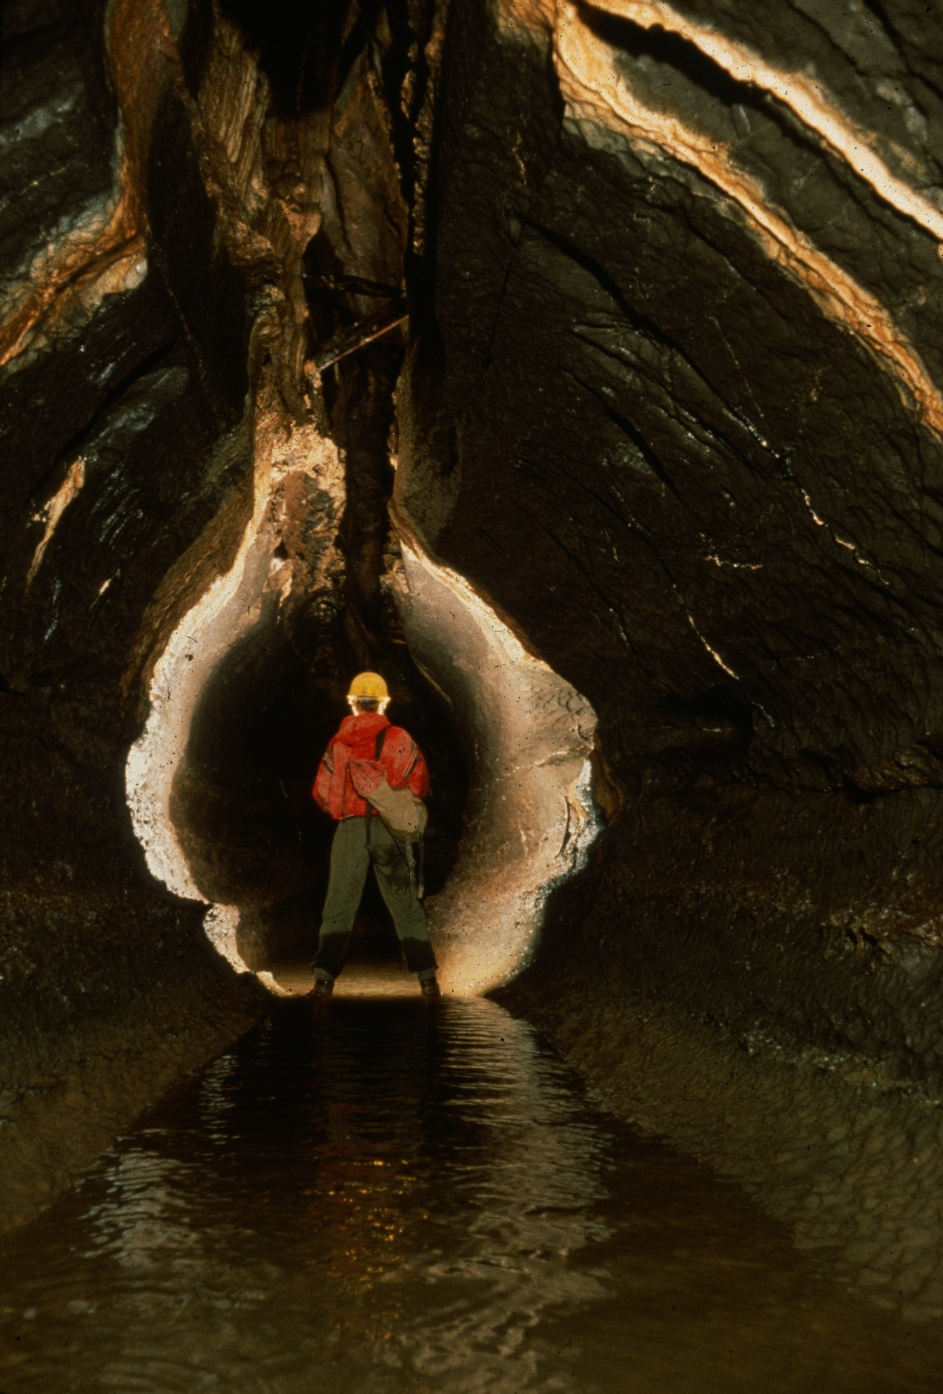
Notes:
More Phun With Phreatics – William Storage

Slide 37
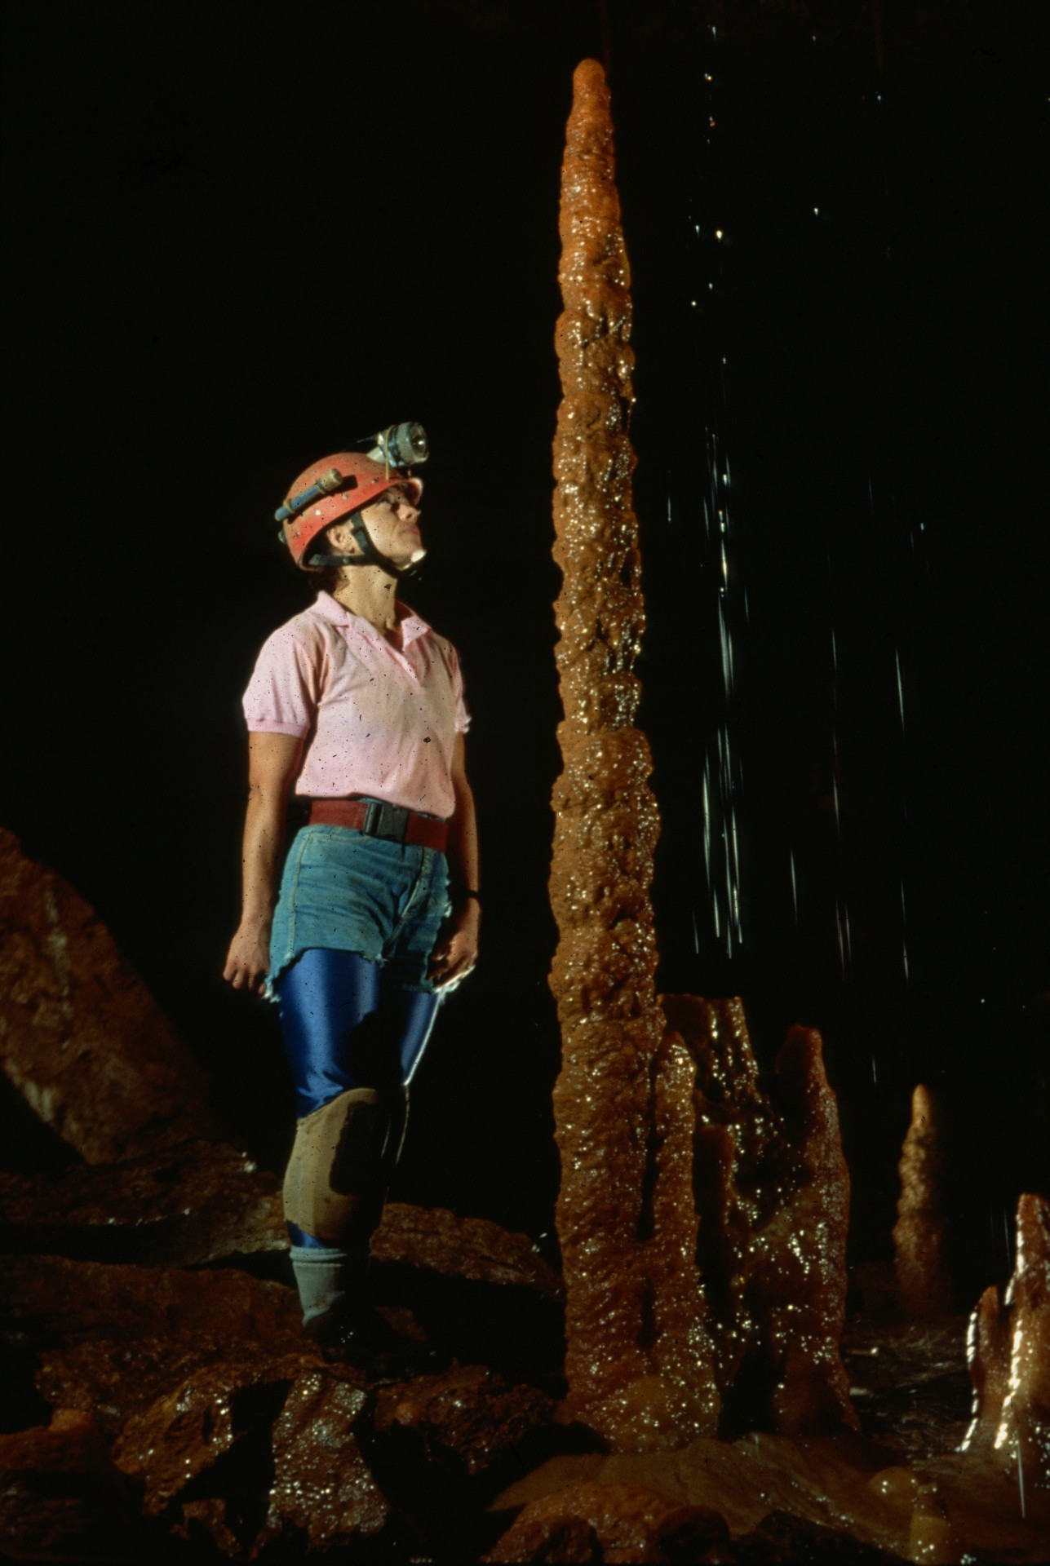
Notes:
Pagoda and Pour Spout – Rick Day

Slide 38
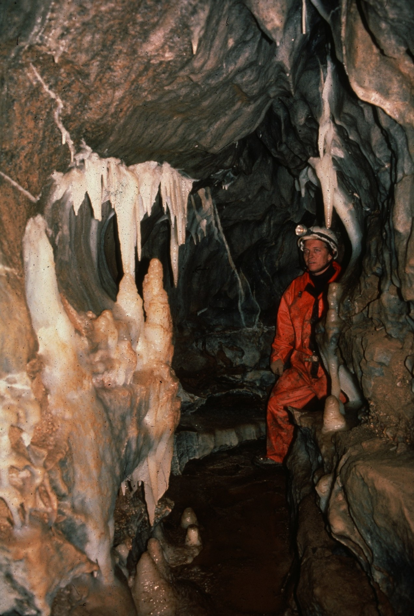
Notes:
Soldier’s Glory – William Storage

Slide 39
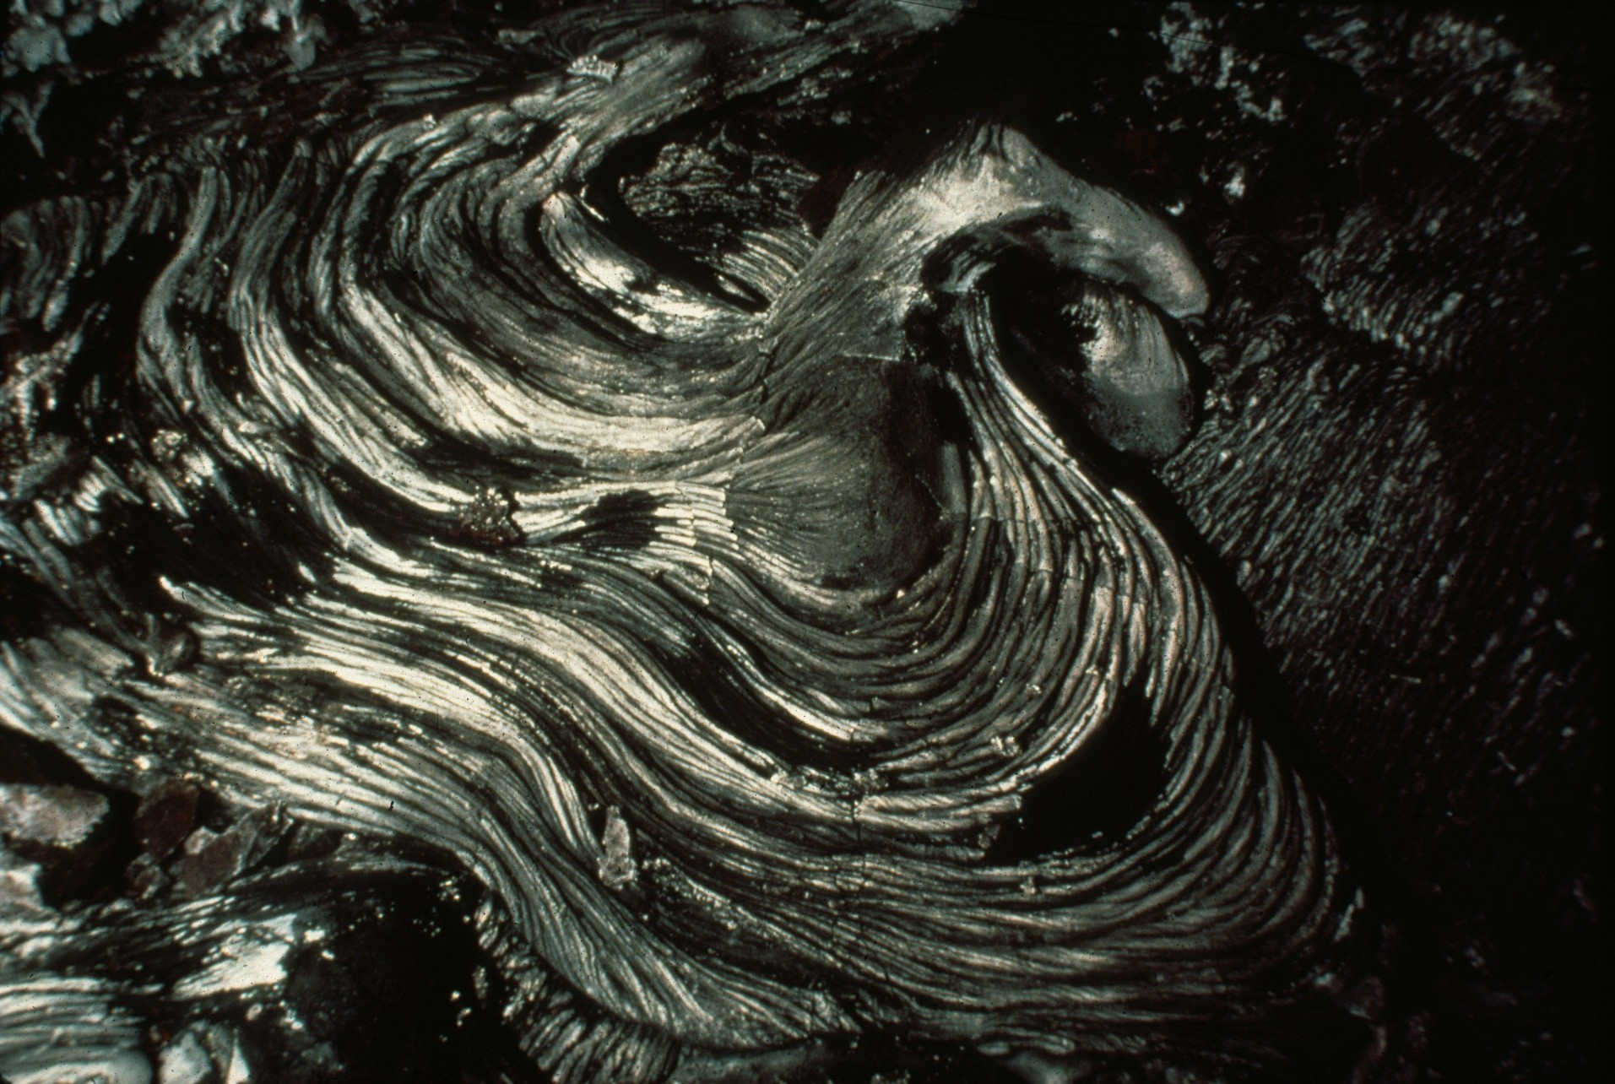
Notes:
Gypsum-Crusted Pahoehoe – Dave Bunnell

Slide 40
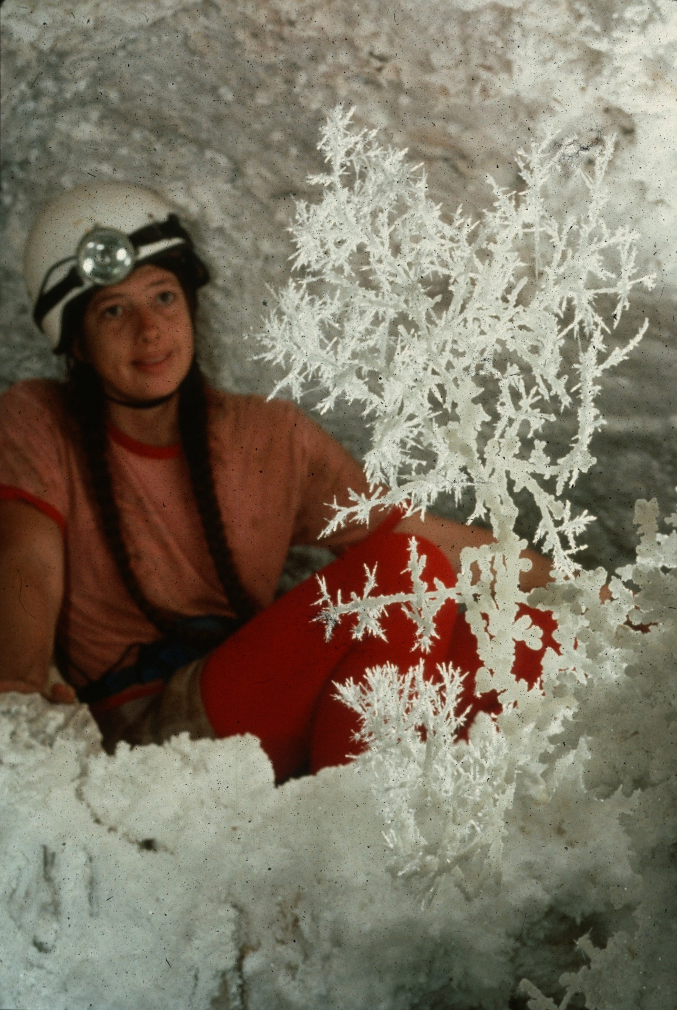
Notes:
The Perfect Aragonite Bush – Peter and Ann Bosted

Slide 41
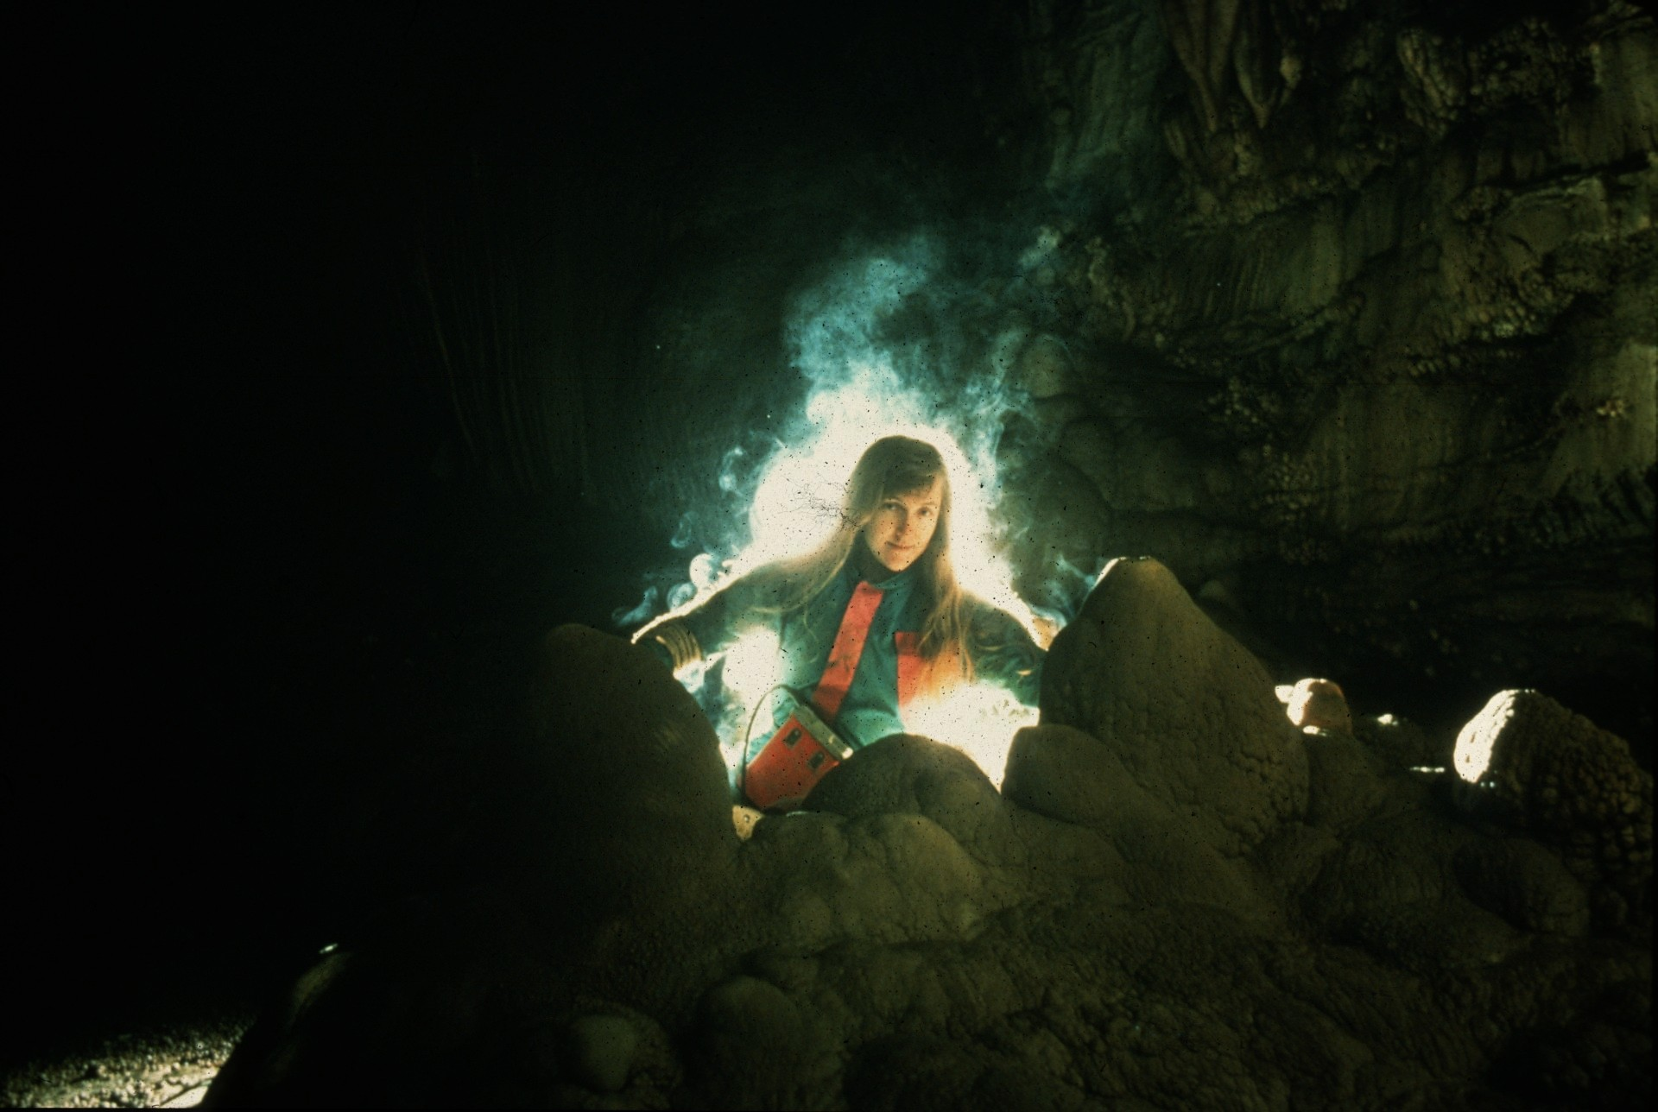
Notes:
I Dream of Genie – John Van Swearingen

Slide 42
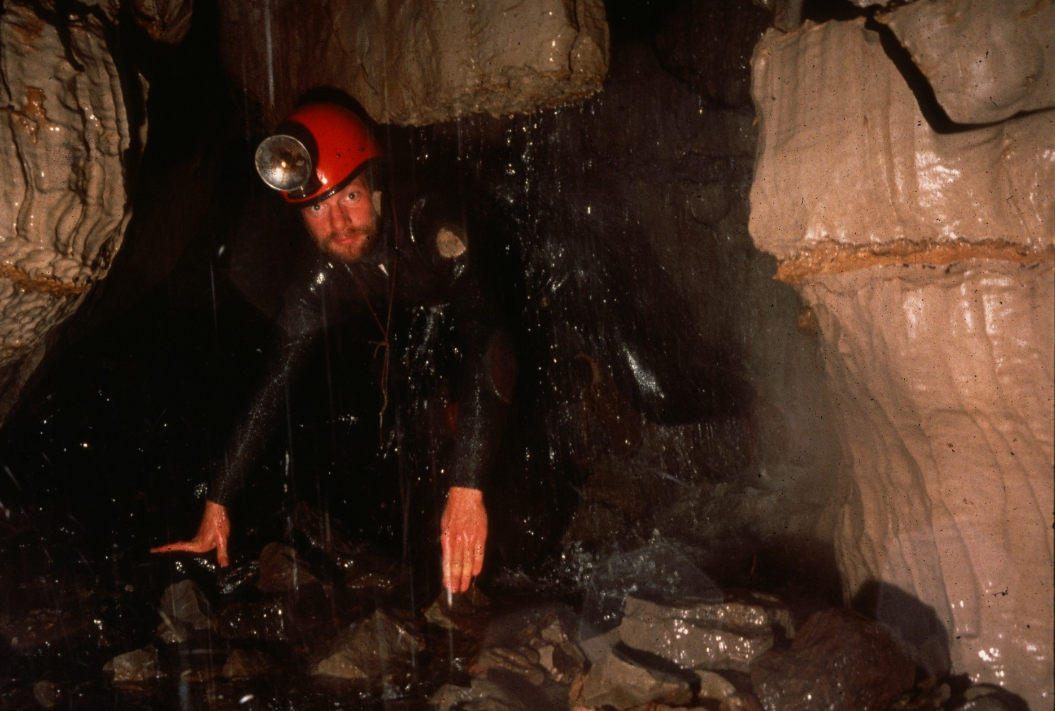
Notes:
Wild, Wonderful Left It Pit – William Storage

Slide 43
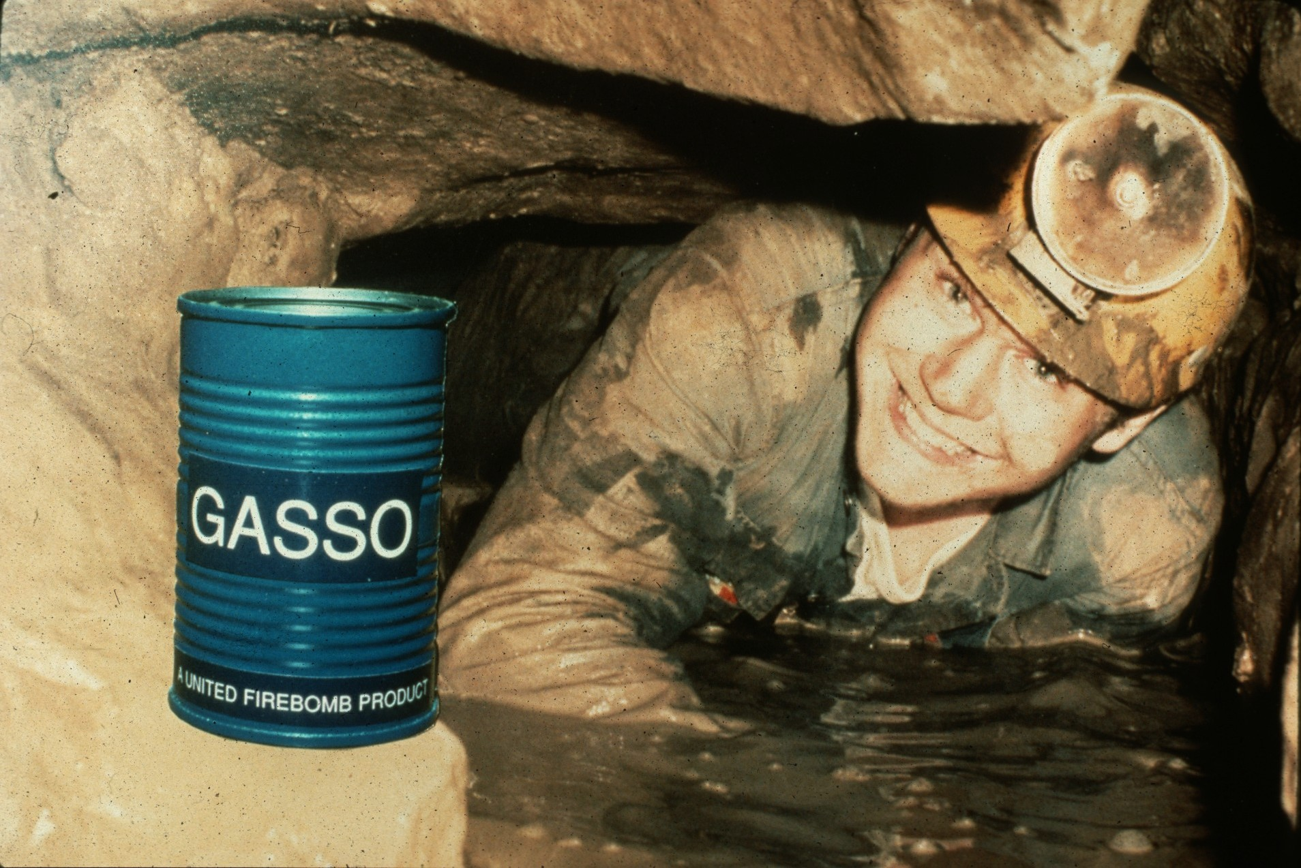
Notes:
When the Going Gets Tough, the Tough Get Gasso! – Richard Vernier

Slide 44
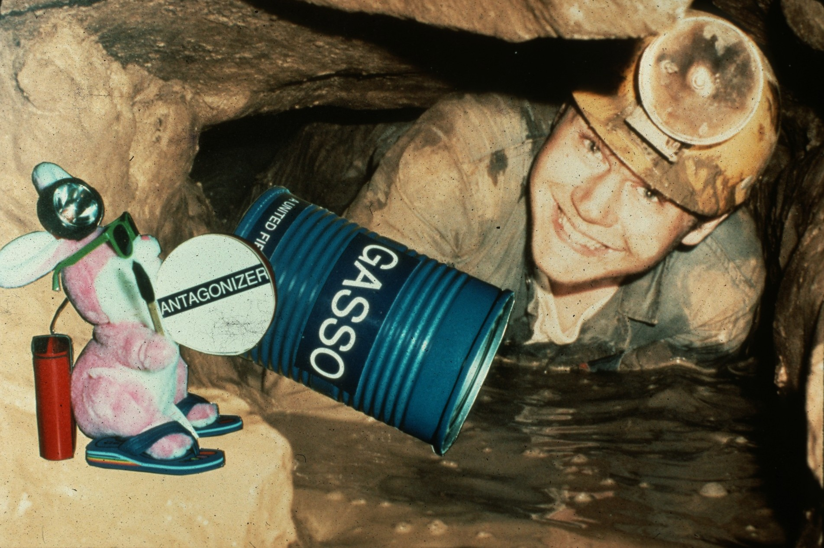
Notes:
…and Going and Going and Going… - Richard Vernier

Slide 45
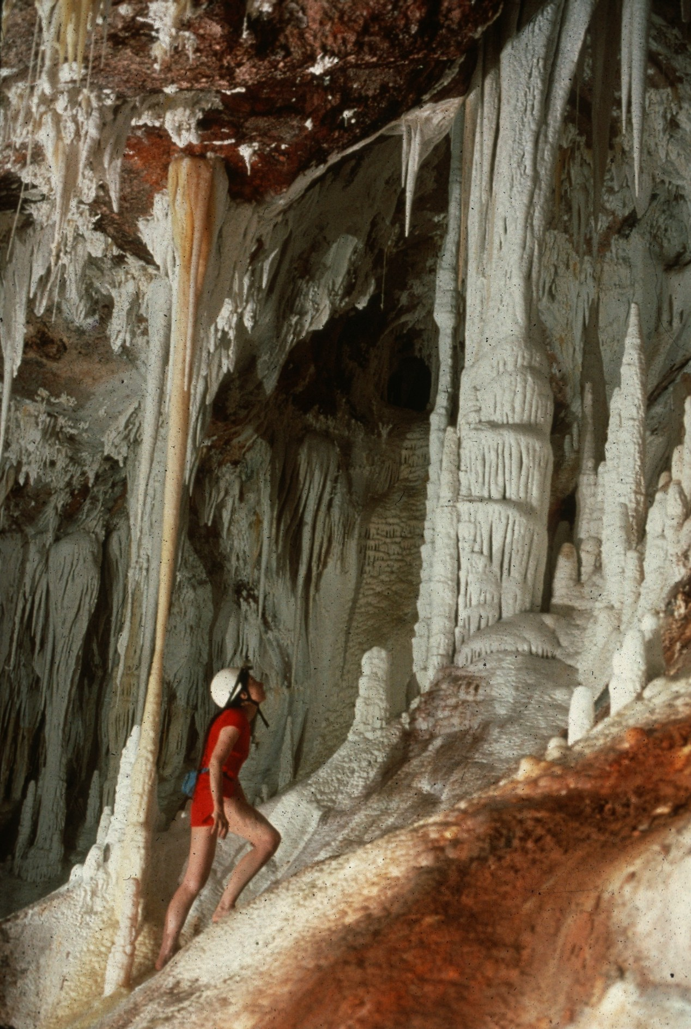
Notes:
Ivory Towers – Peter and Ann Bosted

Slide 46
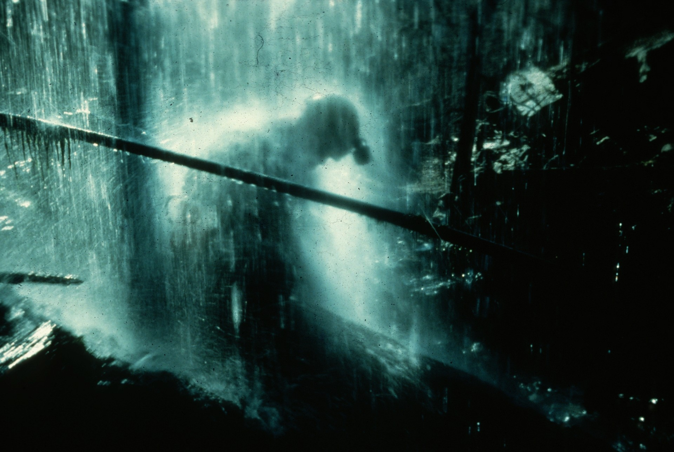
Notes:
Sun Shower – John Van Swearingen

Slide 47

HONORABLE MENTION
PHOTO SALON
Notes:
Entries Which Received Honorable Mention – Green Ribbons

Slide 48
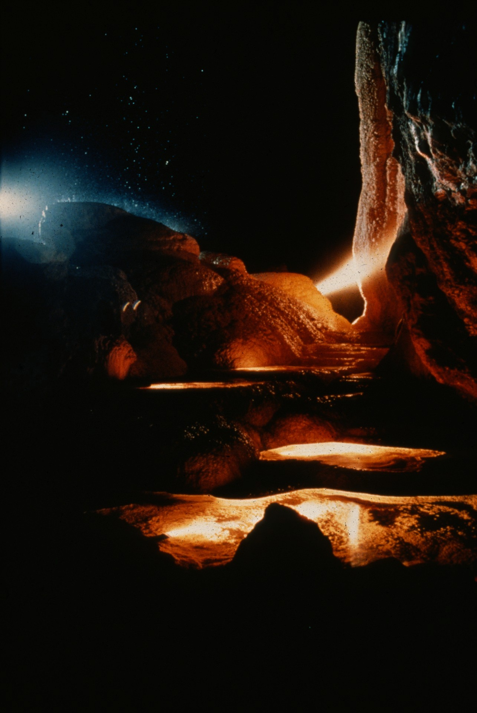
Notes:
Angeles Cave, Puerto Rico – Laura Magruder

Slide 49
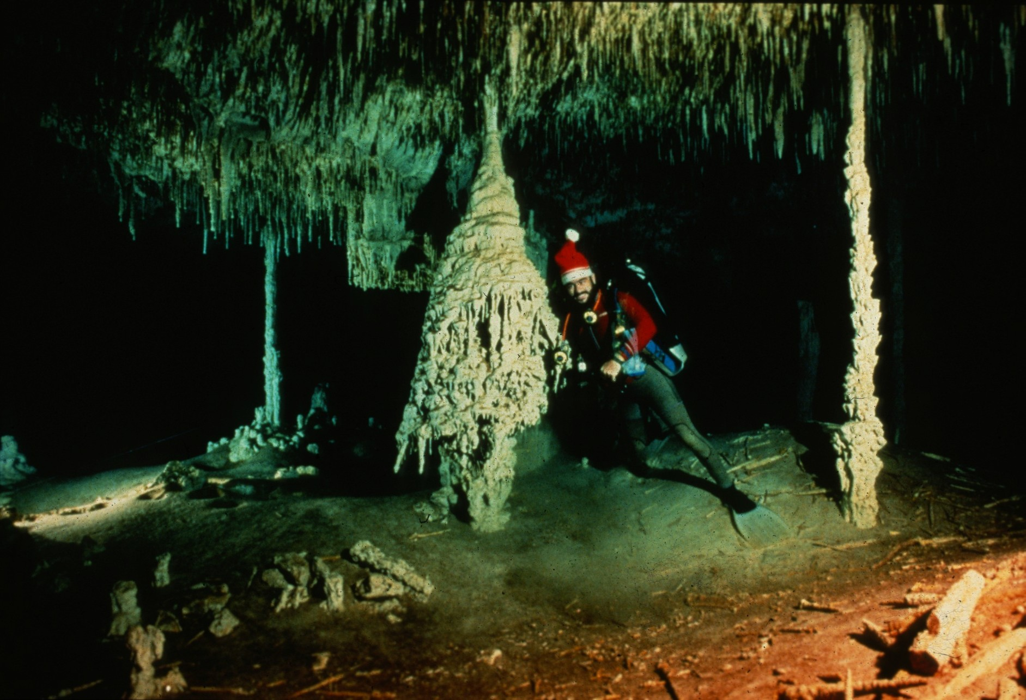
Notes:
Christmas Tree and Santa – Ron Winiker and Mike Madden

Slide 50
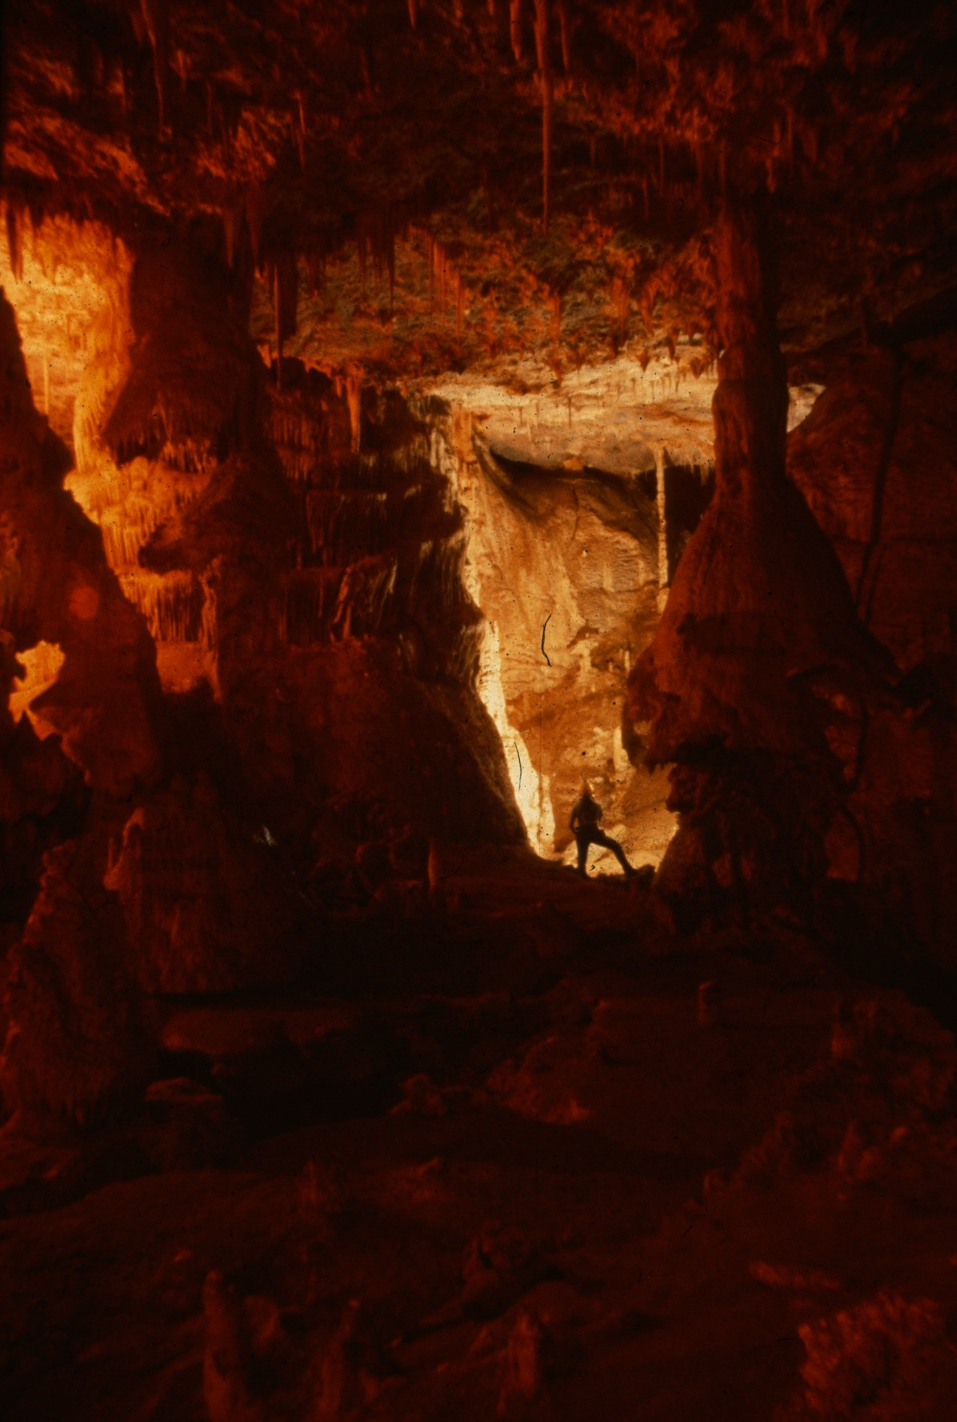
Notes:
Entrance to Middle Earth – Maureen Handler

Slide 51
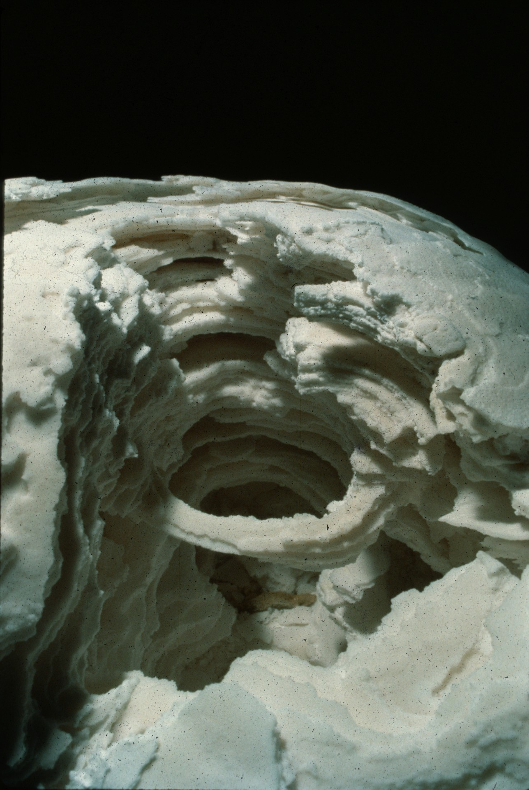
Notes:
Erosion – Dave Bunnell

Slide 52
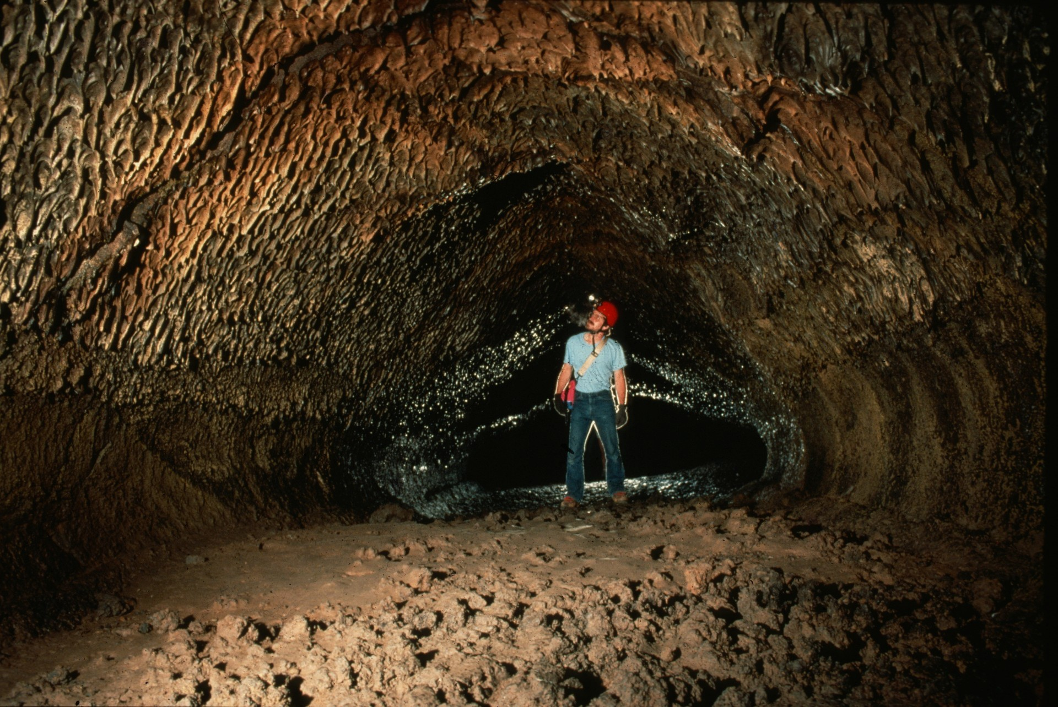
Notes:
Hopkins Chocolate – Dave Bunnell

Slide 53

Notes:
Crystal Gours – Rick Day

Slide 54

Notes:
Angeles Cave, Puerto Rico – Laura Magruder

Slide 55

Notes:
Pearl Explosion – Dave Bunnell

Slide 56

Notes:
Judith Calford, Crag Cave, Ireland – Chris Howes

Slide 57

Notes:
The Nest – Maureen Handler

Slide 58

Notes:
Hoodoo in the Hudson – Peter Jones

Slide 59

Notes:
Cloud Chamber, Dan yr Ogof, South Wales, GB – Chris Howes

Slide 60

Notes:
Vesuvius – Dave Bunnell

Slide 61

Notes:
The “Flag of Cupp-Coutunn,” Turkmenia – Peter and Ann Bosted

Slide 62

Notes:
I’ve Seen the Light – Maureen Handler

Slide 63

Notes:
Pearlsian Gulf – Dave Bunnell

Slide 64

Notes:
Ice Age – Ron Winiker and Mike Madden

Slide 65

Notes:
Reflections in a Lily Pad – Peter Jones

Slide 66

Notes:
Straw Chamber, Ease Gill Caverns, Yorkshire, GB – Chris Howes

Slide 67

MERIT AWARD
PHOTO SALON
Notes:
Entries Which Received Merit Award – Blue Ribbons

Slide 68

Notes:
Suspended Contemplation – Carolyn Cronk

Slide 69

Notes:
Bacon Hole, South Wales, GB – Chris Howes

Slide 70

Notes:
Jennifer, O Jennifer – John Van Swearingen

Slide 71

Notes:
Xibalba Mayan Underworld – Ron Winiker and Mike Madden

Slide 72

Notes:
Cova Negre – Dave Bunnell

Slide 73

Notes:
Nita Diplodocus – Dave Bunnell

Slide 74

Notes:
Angeles Cave, Puerto Rico – Laura Magruder

Slide 75

Notes:
The Tickler – Dave Bunnell

Slide 76
BEST OF SHOW
PHOTO SALON
Notes:
Entry Selected As Best of Show – Medal

Slide 77

Notes:
Hole in Time – Ron Winiker and Mike Madden

Slide 78
Photographers
Notes:
Photographers

Slide 79
Photographers:
  Djuna Bewley
  Peter and Ann Bosted
  Dave Bunnell
  Carolyn Cronk
  Rick Day
  Ralph Earlandson
  Scott Fee
  Maureen Handler
  Horton Hobbs, III
  Louise Hose

Slide 80
Photographers:
  Chris Howes
  Pat Jablonskiy
  Peter Jones
  Mike Madden
  Laura Magruder
  Ed McCarthy
  Carl Samples
  William Storage
  John Van Swearingen IV
  Richard Vernier
  Ron Winiker

Slide 81

An NSS Audio-Visual Library Presentation
The Best of the
1992 NSS Photo Salon
Original slide program S915
Slides digitized by David Caudle
PowerPoint program created by Jim McConkey
81 slides, with script in presenter notes
PowerPoint created 2/24/2021
National Speleological Society
6001 Pulaski Pike
Huntsville, AL 35810-1122
256- 852-1300
nss@caves.org
https://caves.org/

